Slide 1
Soil Structure, Cultivations and Establishment.
Soil Health: The key to success of any farming system
Philip Wright
Wright Resolutions Limited

Slide 2
Soil Structure, Cultivations and Establishment.
Discussion: how can we maximise the benefits of a healthy soil.
Prevention of soil damage: options
Soil Repair – roots and metal
A pathway to Regenerative Agriculture.

Slide 3
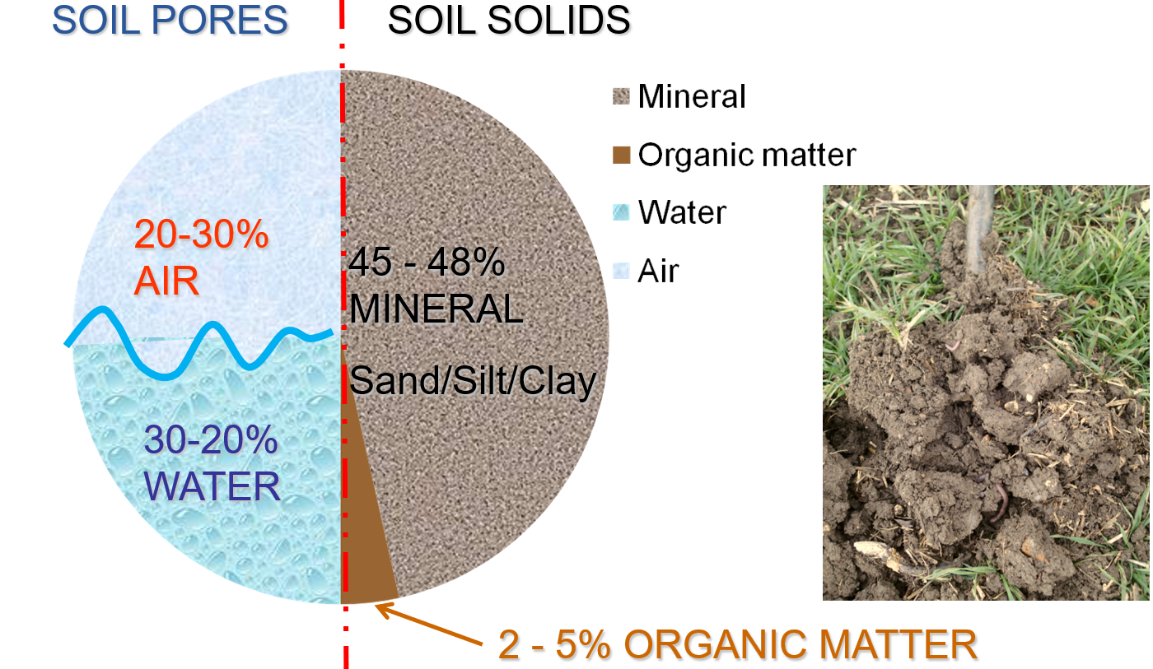
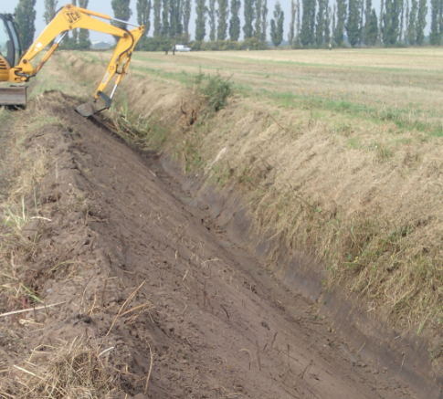
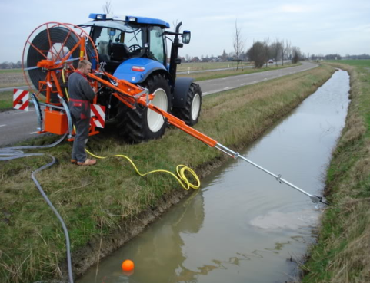
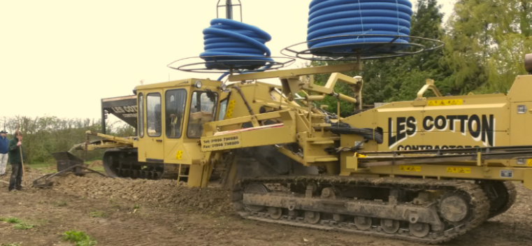
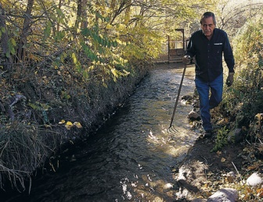
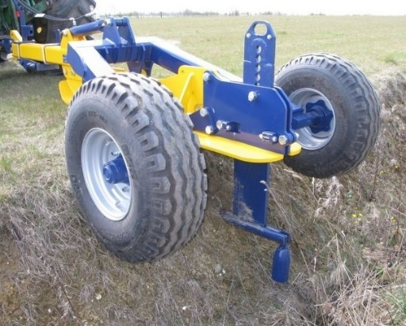
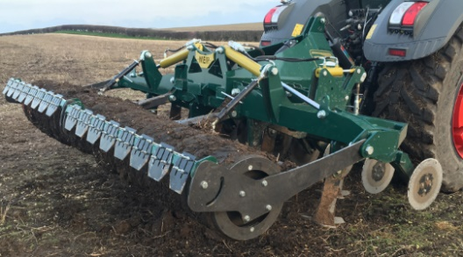
Drainage: a key cornerstone for effective farming.
  Causes of poor drainage:
  Where is the problem?
  Ground water – ditches, drains
  Surface water – pans/barriers
  Identify the cause.
Mole drainage: has a role on appropriate soils
Biology needs oxygen – a fast return to field capacity is essential
Intensive cultivations destabilise soil
It’s very difficult to direct drill poorly drained soil.
Notes:
3

Slide 4
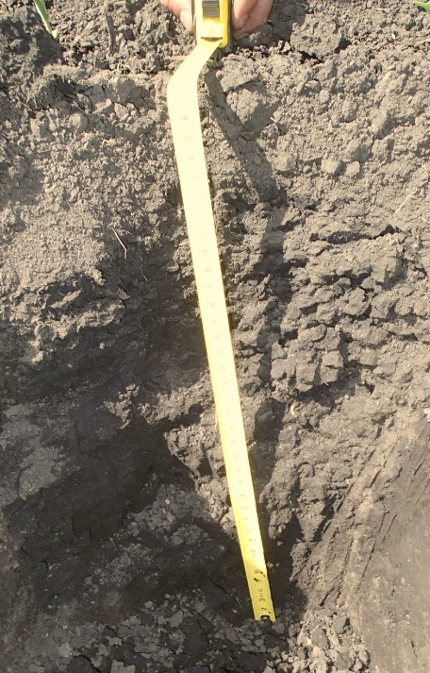
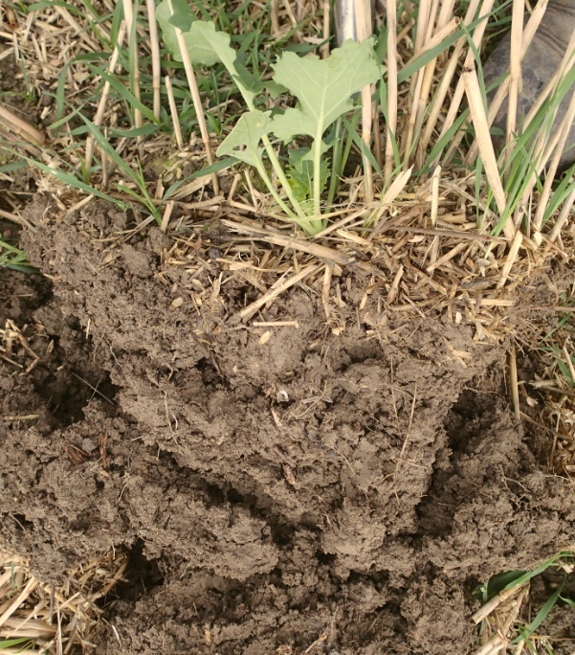
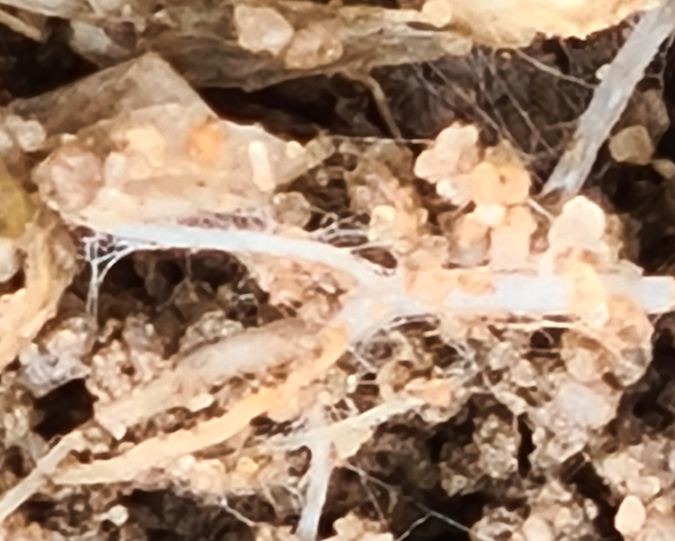
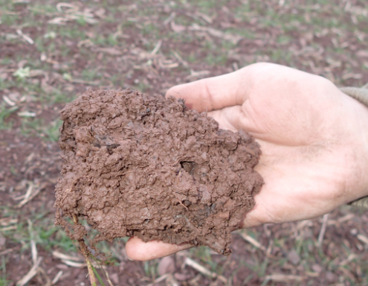
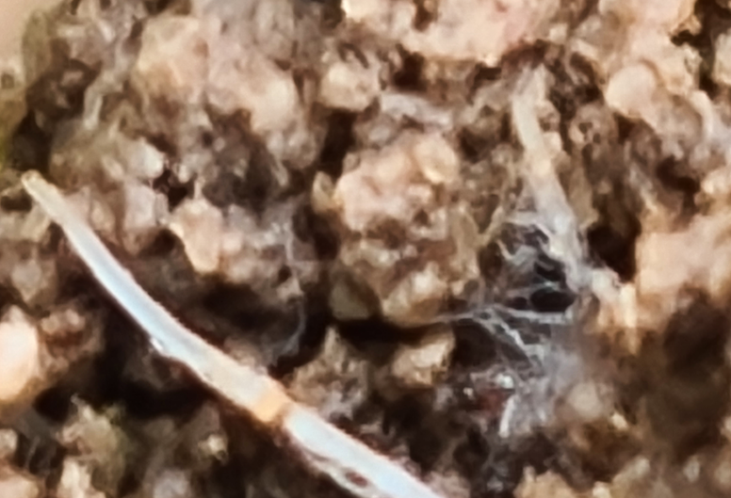
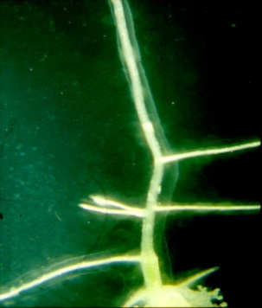
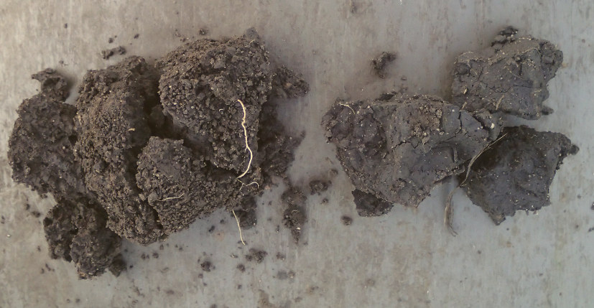
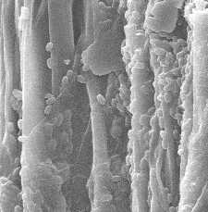
Soil Structure – Aggregation
  Good aggregation – water stability, good pore space, gaseous exchange, good water, air & root movement;
  Closely tied to Organic Matter and biological activity.
Notes:
4

Slide 5
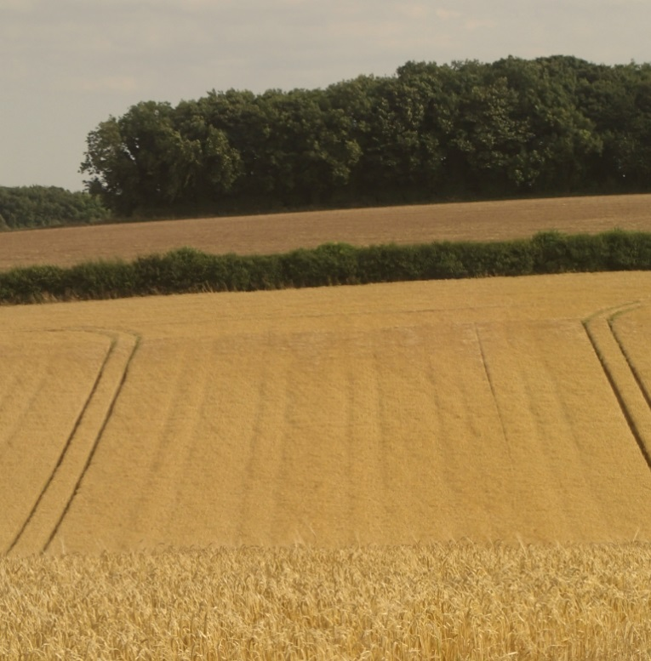
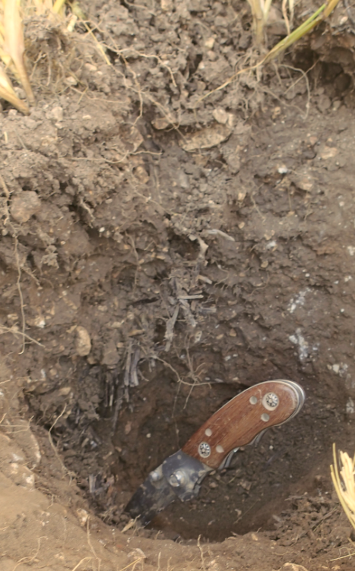
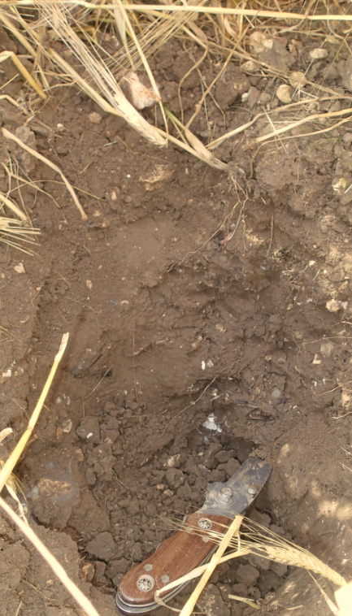
The hidden cost of compaction
Between Wheelings
In Wheeling
Yield losses are significant!!
Notes:
6m Rapide/Deere 8430 on 650/85-R38 & 600/70-R30

Slide 6
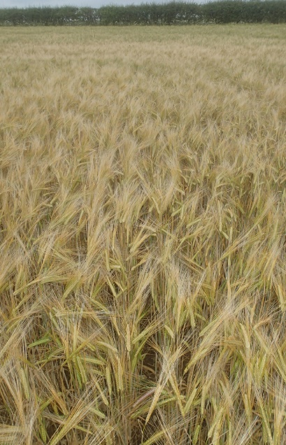
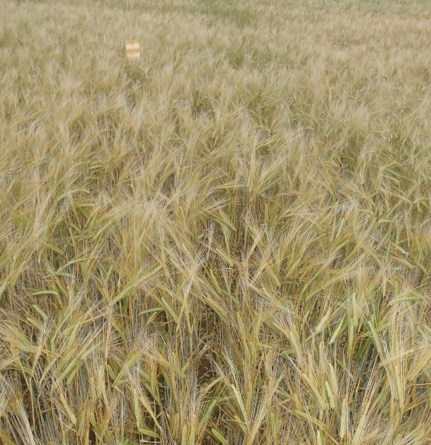
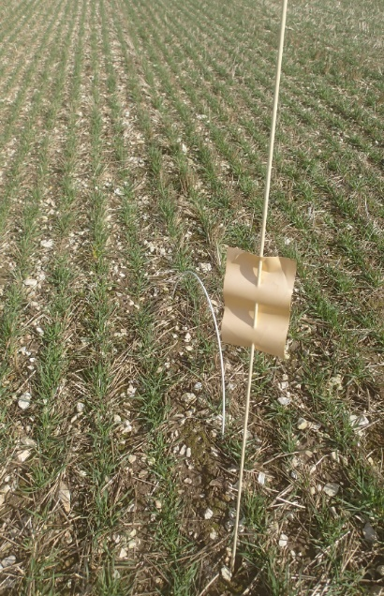
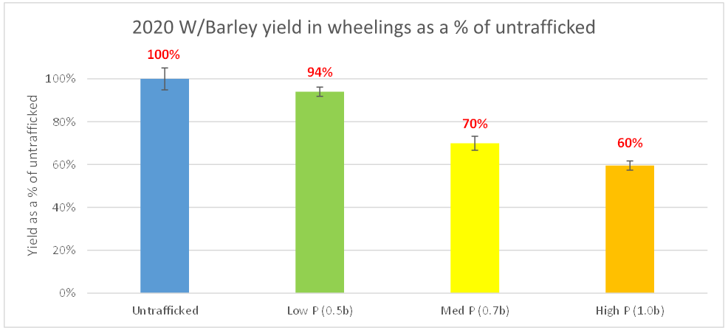
Direct Drilling Tractor Pressures Comparison 2020
1.0b
0.5b

Slide 7
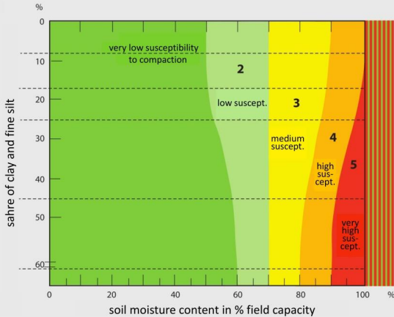
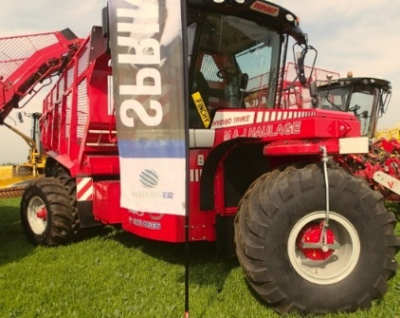
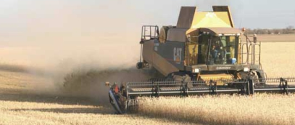
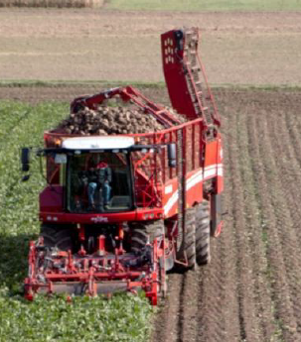
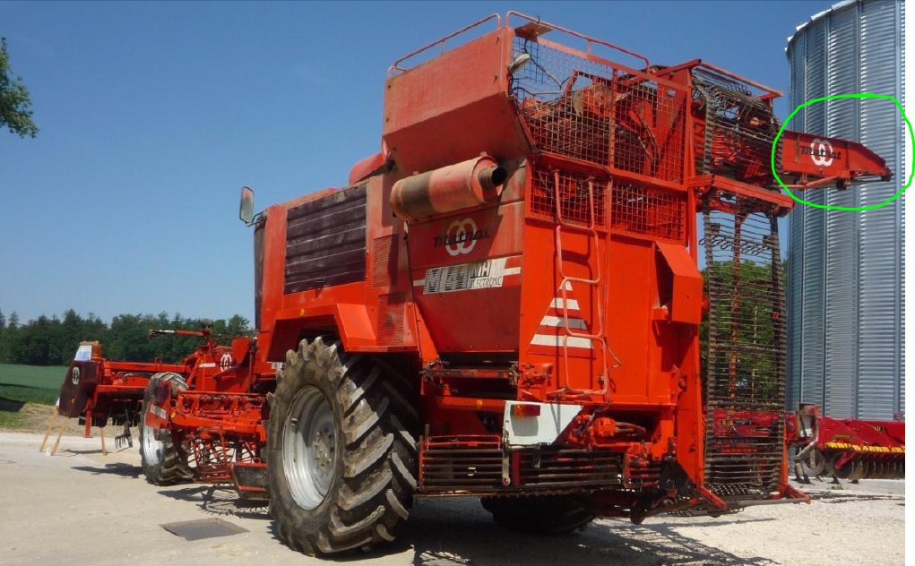
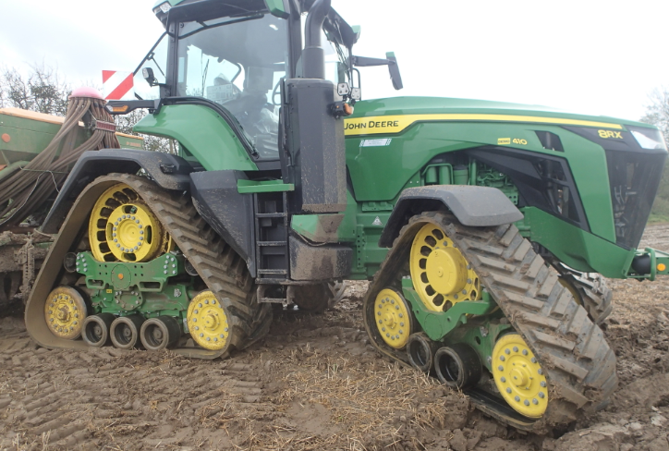
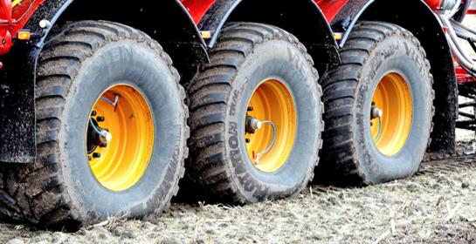
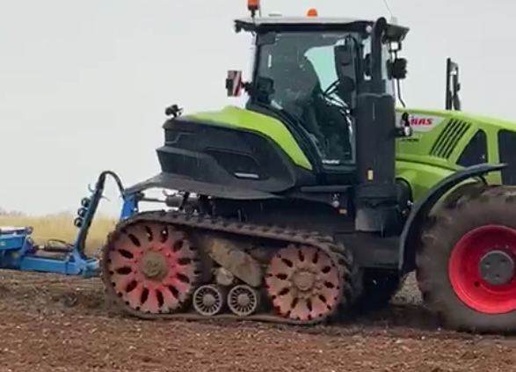
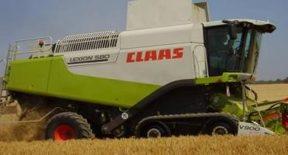
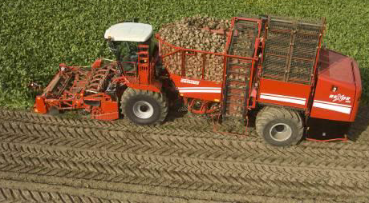
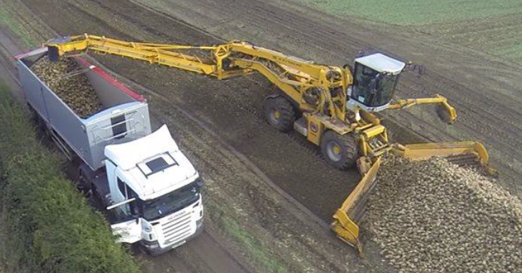
Options for compaction reduction
The combine is the first cultivator
Assess damage susceptibility:
Avoid high risk fields in wet conditions
Avoid high pressures
Minimise axle loads
Trailers/chasers need extreme care & tight control
Headlands can be a special case.
Controlled Traffic
Managed pressure/axle load – Controlled Pressure
Target Ground Pressures ideally to 0.7b or less

Slide 8
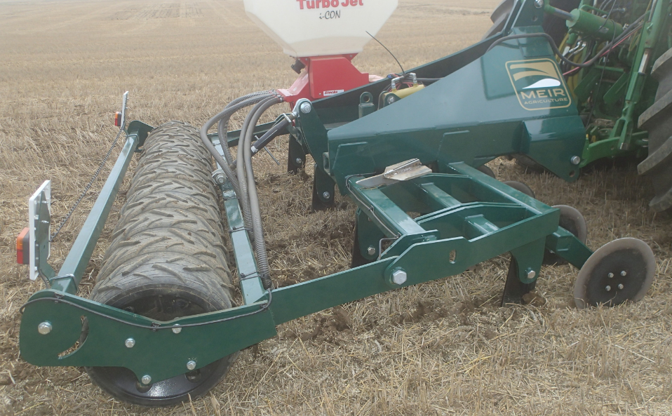
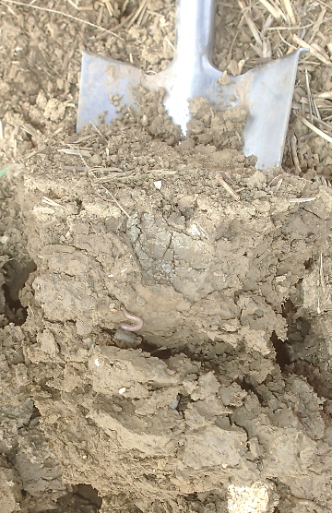
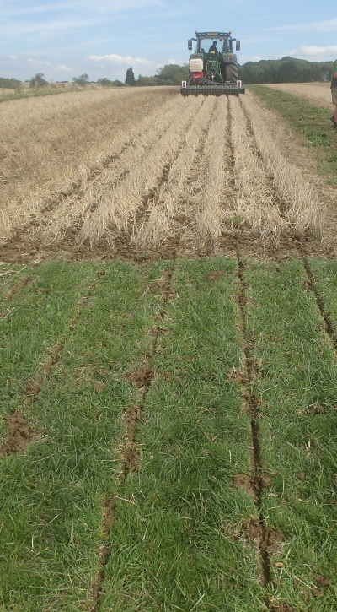
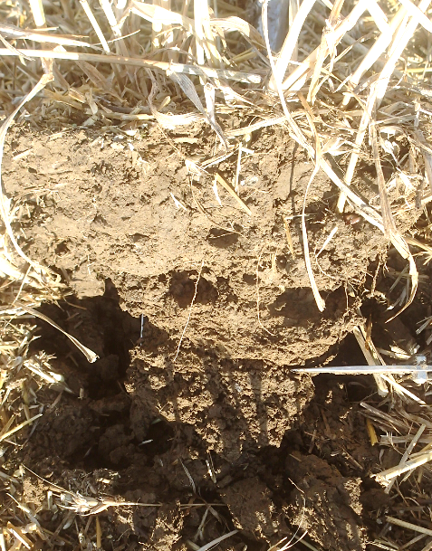
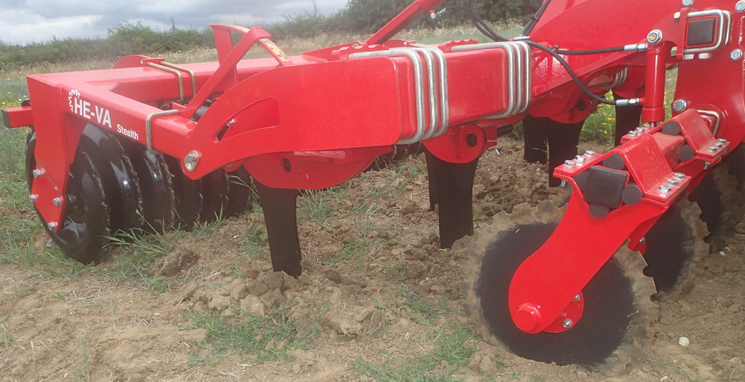
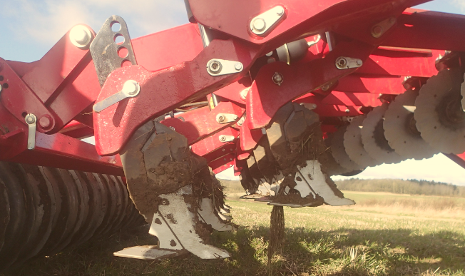
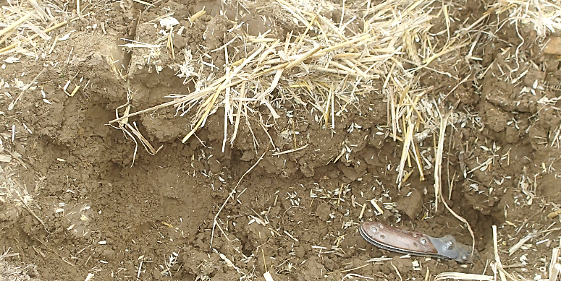
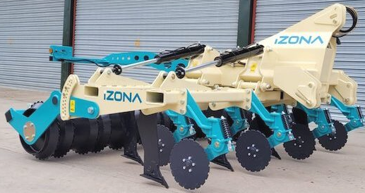
Damage repair: combined use of roots and metal
NOTE: if it’s not broken, there’s no need to fix it……
Notes:
ROOT/METAL SYNERGIES; “LESS IS MORE”

Slide 9
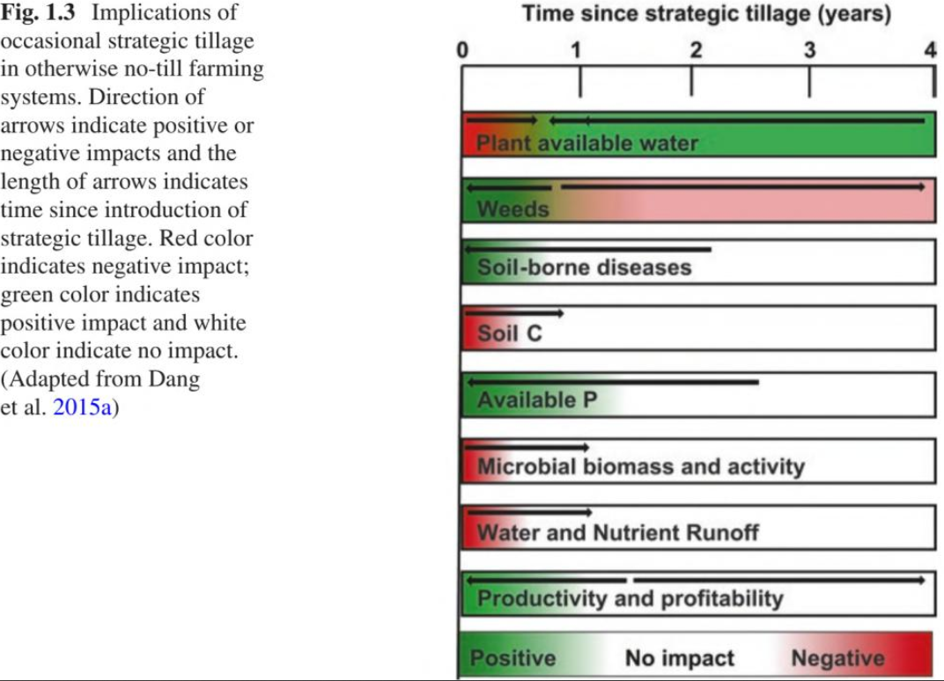

The Path to Regenerative Agriculture
Effect of occasional Strategic Tillage in otherwise no-till farming systems.
  Problems with no-till can be solved by occasional Strategic Tillage (ST). These include:
    Weed & pest control
    Compaction and infiltration issues
    SOC sequestration
    Vertical stratification of soil properties
    Loss (run-off) of soluble nutrients
  ST usually has no, or only short-term negative effects
  Marginal negative weed effects can be mitigated by weed seed bank management
  Benefits with no associated downsides are more likely when ST is by deep (inversion/non-inversion) tillage (compared to shallow ST)
  Successful ST needs good choices of:
      Tillage type, and intensity
      Tillage timing and frequency of such operations.
RECOVERY AFTER STRATEGIC TILLAGE IS RELATIVELY FAST (OFTEN 6 MONTHS OR LESS) IN AN OTHERWISE NO-TILL SYSTEM
THIS DEPENDS ON THE LEVEL OF RESILIENCE BUILT UP BEFORE, AS PART OF THE WHOLE ROTATION.
Dang, YP et al, Soil & Tillage Research 152 (2015) 115-123; & pers. comm. 12/21
Notes:
9
9

Slide 10
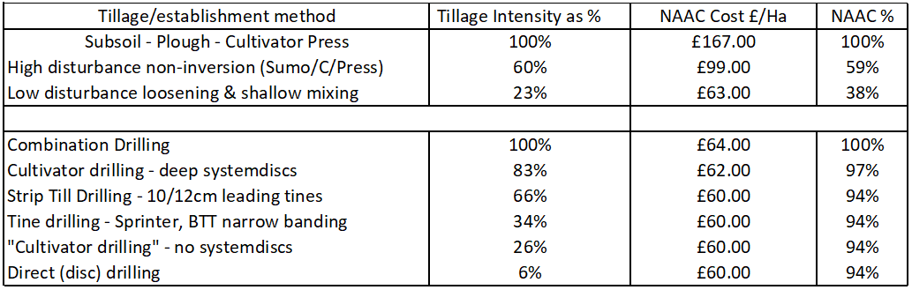
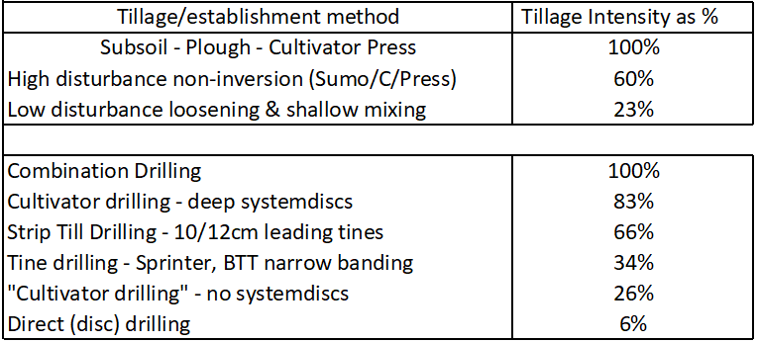
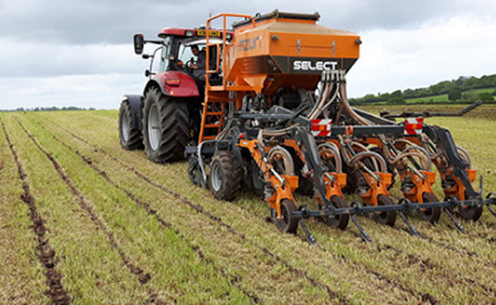
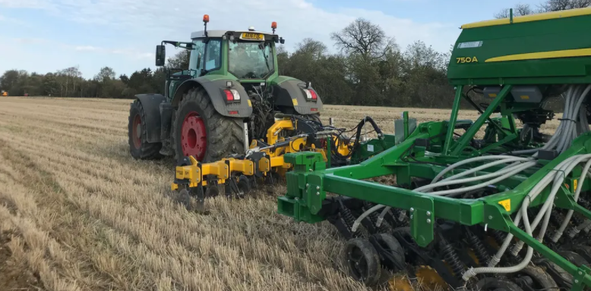
The Path to Regenerative Agriculture
Tillage depth and Intensity: Examples and Mitigation Methods.
  Tillage intensity rating (STIR) depends on:
    Speed of operation
    Type of tillage
    Depth of tillage
    Surface area disturbed
  Benefits of reduced STIR:
  Reduced erosion
  Increasing OM%
  Reduced carbon losses
  Improved aggregation, leading to:
  Less effort to make seedbeds
  Improved soil resilience.
Notes:
10
10

Slide 11
Principles to consider:
Minimise damaging pressures and loads
Ensure soil is structured (vertical fissures) & drainage works
You need appropriate soil conditions!! OM & biological activity help
Have growing roots in the soil when possible
Minimise intensity of cultivations to improve soil resilience & recovery.
Many thanks for listening.
Questions?

