Slide 1


Measuring up to the future water challenges in East Anglia
John Patrick

Slide 2
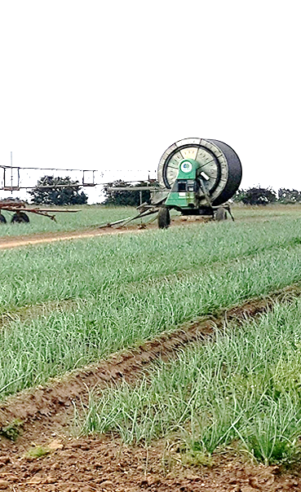
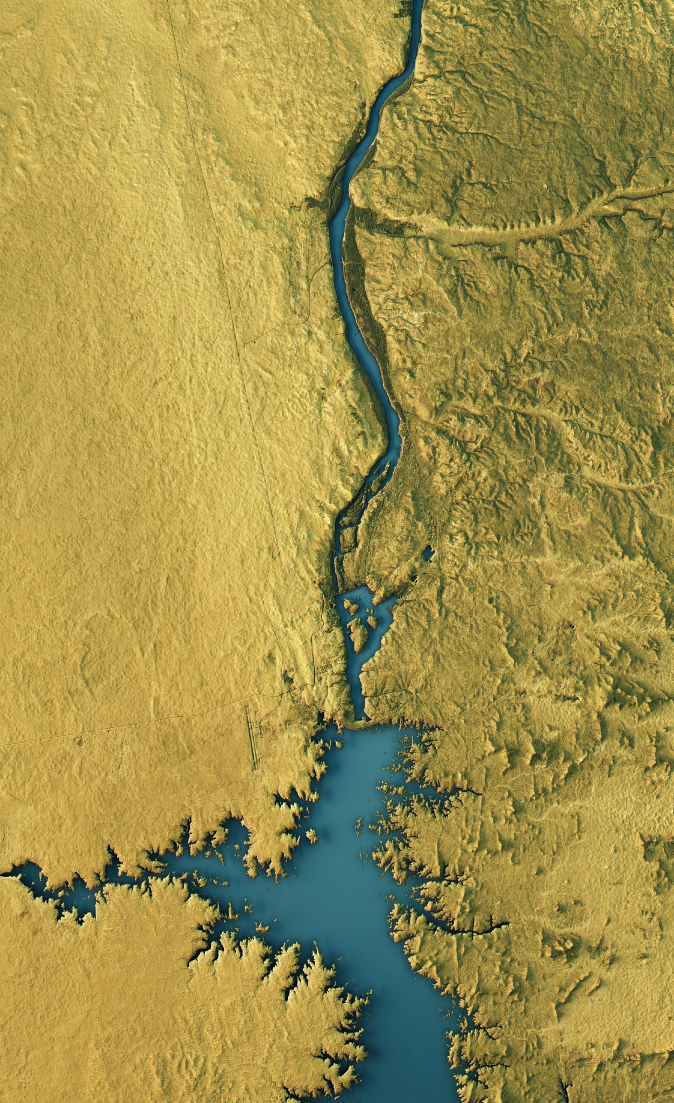
Time to change our habits
Where have we come from ?
Where are we now ?
Where do we need to be ?
Water position in East Anglia – Water Resources East (WRE)
Suffolk challenges – ESWAG Heat Maps
Catch more of what we have – Winter water - Felixstowe Hydrocycle
Innovate: Managed Aquifer Recharge (MAR)

Slide 3
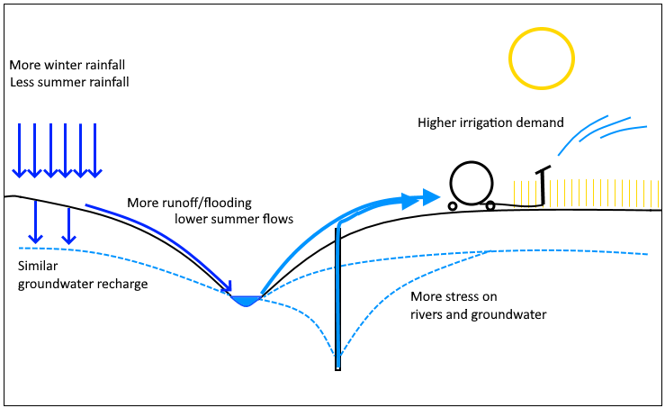
Water Flows

Slide 4
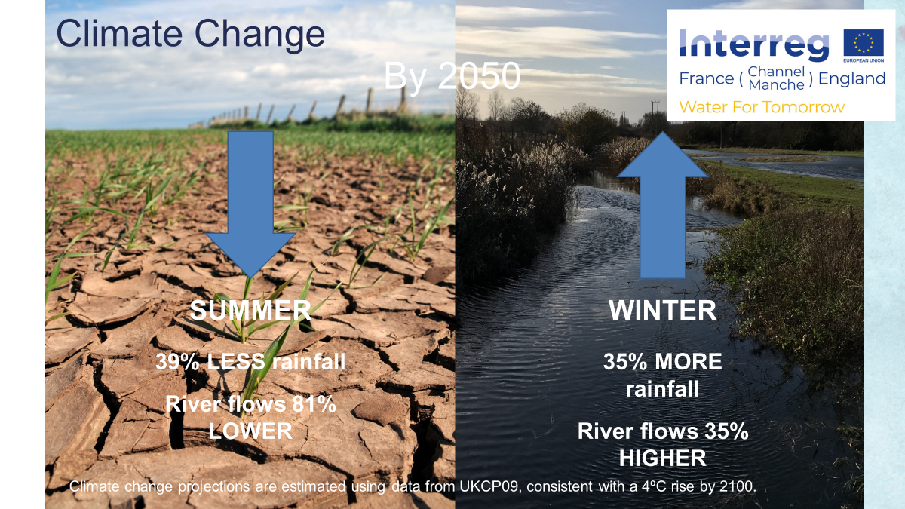
Climate Change by 2050
Notes:
Me
It goes with out saying that impacts could be severe in the summer months. The impacts of climate change are already being felt with more numerous and prolonged dry periods. Further impacts will be felt affecting the quantity and availability of water for all users.
It is predicted that by 2050 the East Anglian region can expect rainfall to be 39% lower in summer resulting in flows being 81% lower. On the flip side of that we can expect 35% higher rainfall and peak flows in winter.
Climate change projections are estimated using data from UKCP09, consistent with a 4ºC rise by 2100.

Slide 5
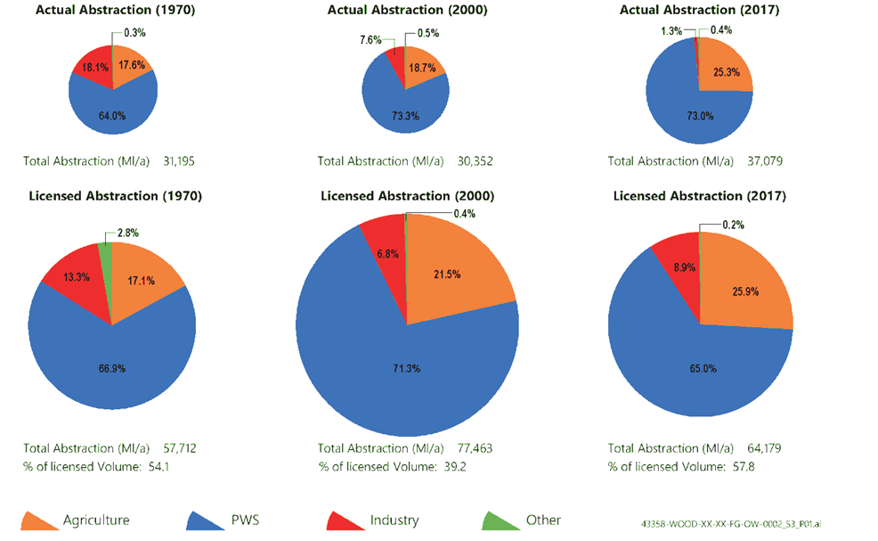
Historic Water Usage
1970
2000
2017
7,000,000 m3/year more than in 2000
13,000,000 m3/year less than in 2000
Business As Usual is not an option – Licence reductions are inevitable
Notes:
Describe slides. snapshot of abstraction licensing. Although the EA has slowly been reducing the quantity of water licensed in the catchment, the actual uptake of water has increased. This has primarily been in the Agricultural sector where the quantity of water used for irrigation has increased from about 30,000Ml/a in 2020 to 37,000Ml/a in 2017. Recent work by ESWAG shows irrigation uptake increasing by 3% year. Water Co abstraction has barely changed.
Increase in SI uptake is mostly as a result of increases in groundwater licence uptake (but winter storage plays a part)
As discussed earlier (Huw and Hari) continued growth is not viable. On the contrary reductions will be necessary to gw and summer river water licences. Major changes to water abstraction affecting pws, industry and agric.
Water Co’s working with the EA on strategic level to plan sustainability reductions
WRE also looking at strategic regional responses but agricultural sector currently taking a piecemeal approach.
Need to develop strategic plans.
Next few slides looks at what licences are likely to be affected and may these changes might come into effect

Slide 6
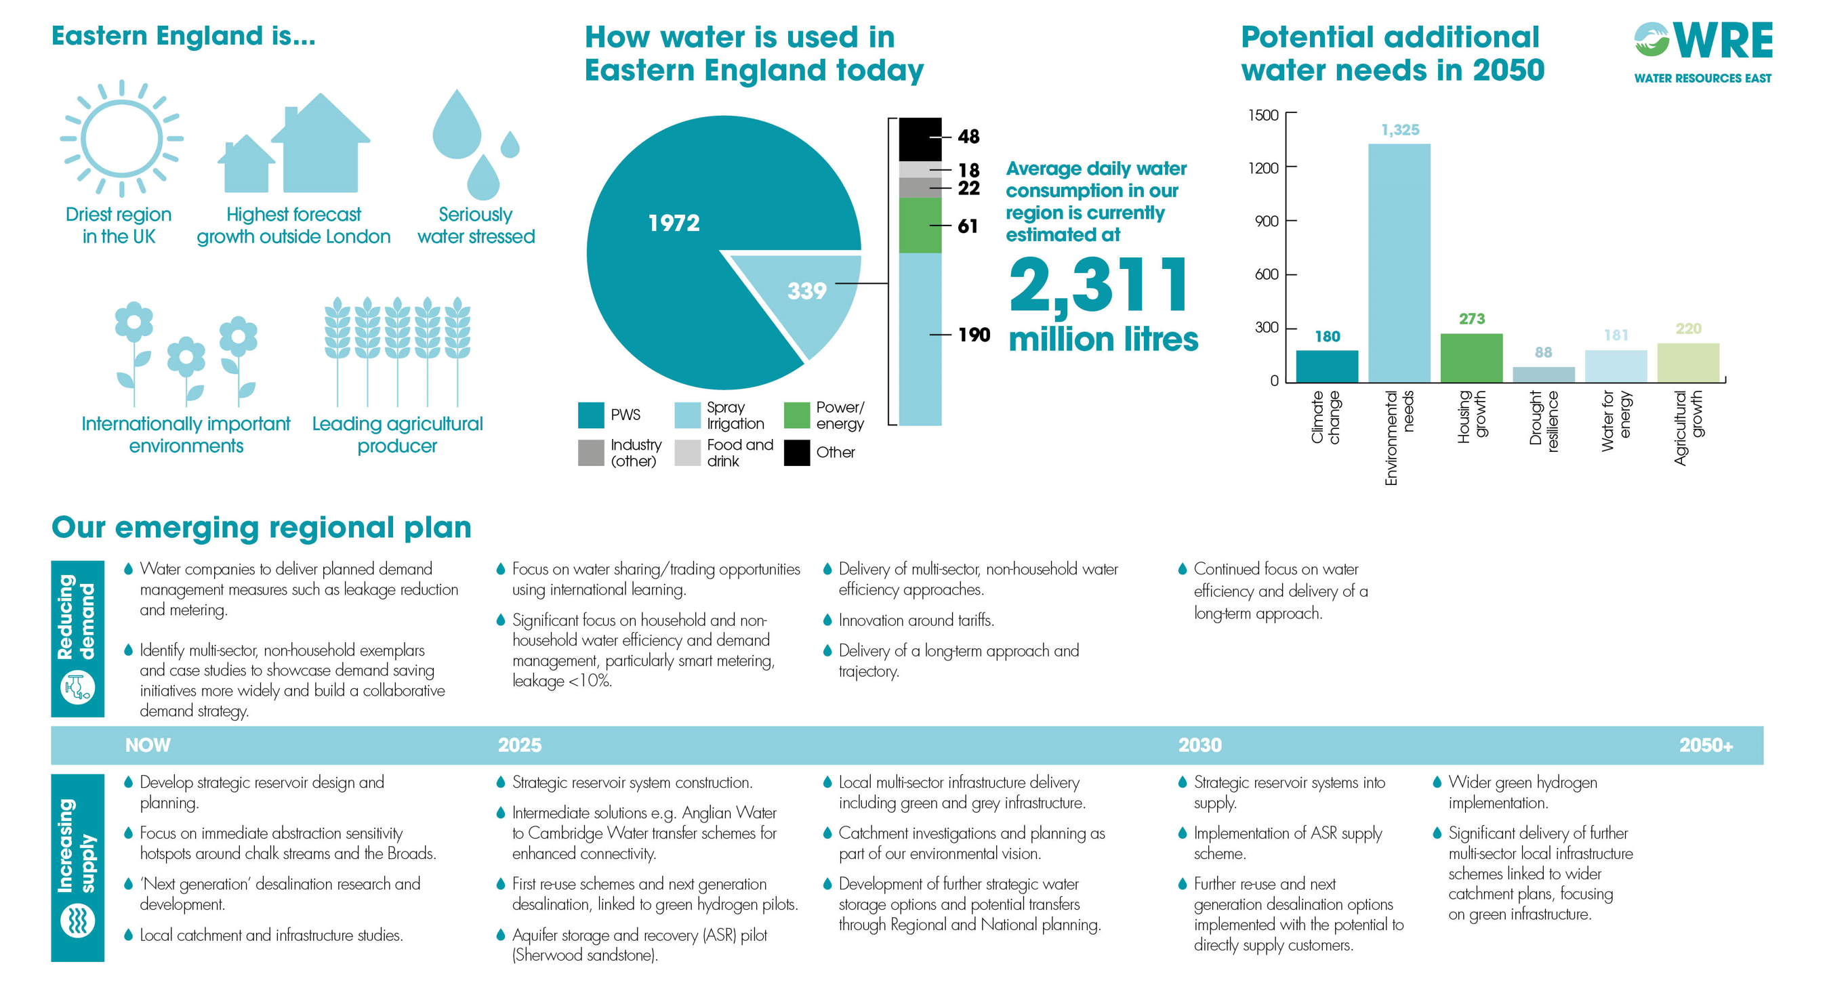
2,267 extra million litres per day
Find out more at waterresourceseast.com
Notes:
Not necessarily that water demand is to double.
New sources needed
New ways of getting that water…. not new water…. E.g. shift from GW to SW downstream – shows importance of looking at catchment level
Consider ambitious scenarios in case
Pop growth – genuine extra growth unless become super efficient.
Demand management could mitigate major areas.
Retrofitting is essential –need more join up with energy etc
Key points in the plan:
Worst case,
will need 2,267Ml/day of new water resources by 2050
of which 1,325Ml/day (58%) is to meet sustainability reductions
plan includes an additional 220Ml/day for agriculture
environmental destination and ambition underpin the process (destination= where are we going, ambition = how quickly do we want to get there)
the higher the destination, the more constrained existing abstractions will become and the greater the need for new sources to replace them
groundwater abstractions will need to be reduced by >50% of current levels to meet environmental flow indicator (EFI) targets for associated surface waters.

Slide 7
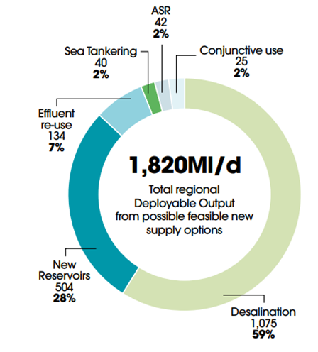
WRE’s Proposed Supply Options

Slide 8
Possible Abstraction Licensing Timescales
Date | Regulation/Policy | Licences affected | Likely Modification
2018 ongoing | Revocation of unused licences | Unused or low uptake | ‘Voluntary’ reductions
2021 ongoing | Trading and variation policy | Trades and variations (groundwater) | Reduction to average uptake
2026 | Time limited licence review | Time limited licences (E Suffolk) | Reduction to recent max uptake
2028 | Environment Act Removal of compensation | Unsustainable non-time limited licences | Reduction to sustainable levels
>2028 |  | All licences | Reduction to sustainable levels
Notes:
To plan alternative resources and potentially ways of working/regulating the available resource it is essential to understand likely qty/reliability reductions.
We cant pre-empt EA response to regulatory changes but we can see what strategy and legislative changes are ahead and take a best guess..

Slide 9
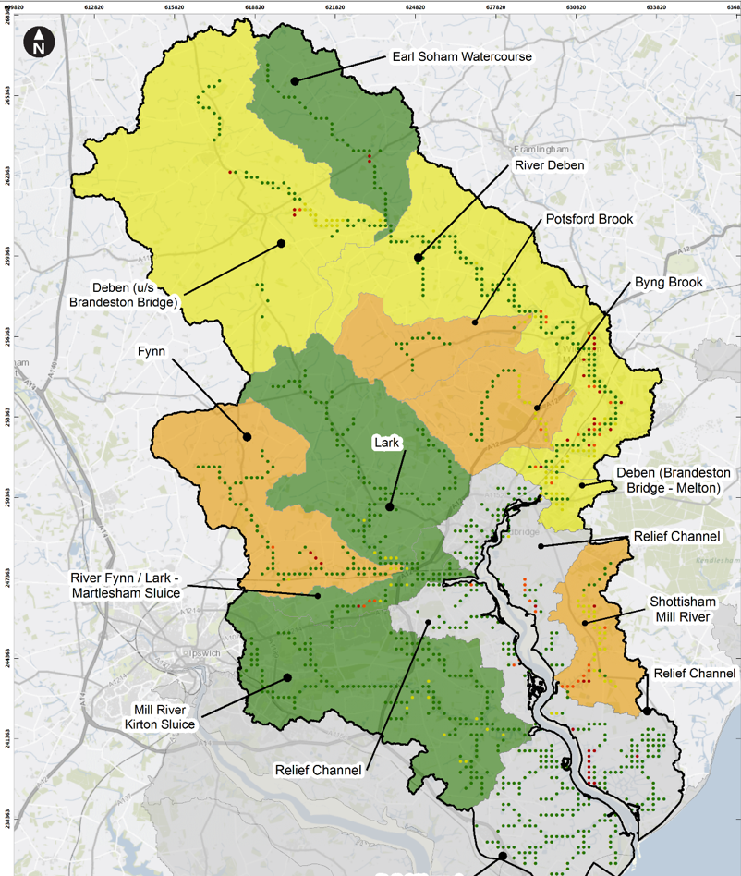
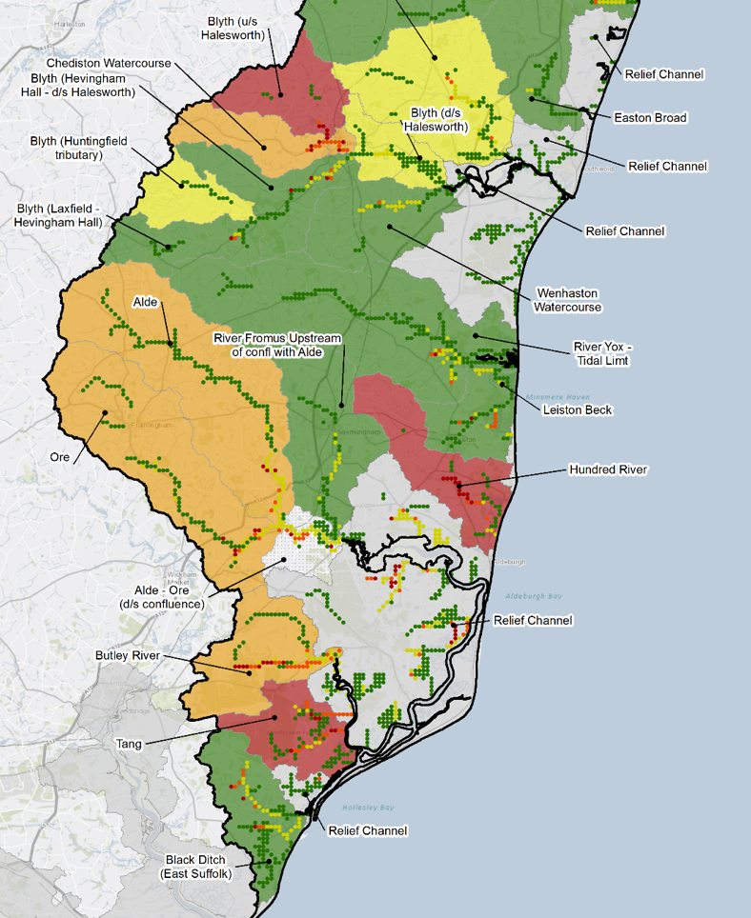

Quantity and Location of Reductions:
ESWAG Heat Maps
Notes:
First iteration of the ESWAG heat maps 2020. Aims to show location and severity of reductions required. . Based on modelled impact of groundwater and surface water abstractions on flows, but also includes discharges (e.g. SWT). Red is where impact is worse, green least bad.
Estimates of quantities (% reduction required) are available in the published doc. Uncertain, but 20% reduction in gw overall E Suffolk possible
Health warning – lots of green. Care is required in interpretation. This is a bulk WB calculation. Some catchments look ok but this is due to positive effect of STW discharge at end.
Interpretation. Helps to have local knowledge. Tang – red due to surface water summer licence
Hundred River red; due to pws groundwater licences.
Additional cautions –
Does not account for NEP (water co sustainability reductions)
Cannot discount unknown factors –e.g. Norfolk Broads gw impacts– (birds freshwater flows 2006) fish scenting flows

Slide 10
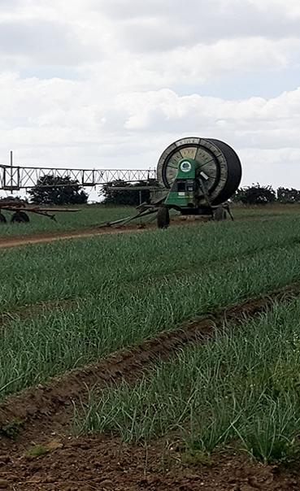
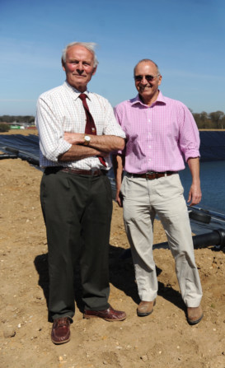
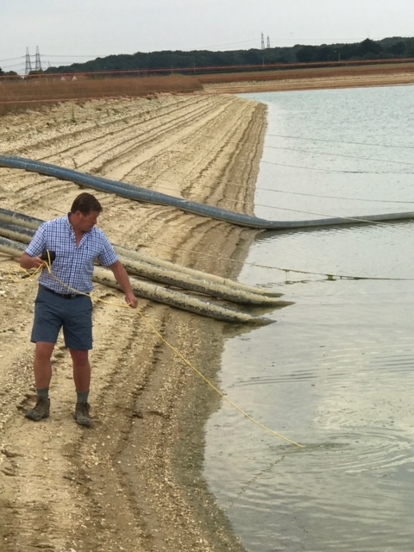
What are we going to do about it ?
Change our behaviour !
Agreement needed between water stakeholders to act collectively.
Realism, speed and adaptability from policy makers. DEFRA / EA.
Understand the rules of the game for the next 25 years.
Support agriculture as we do Public Water Supply .

Slide 11

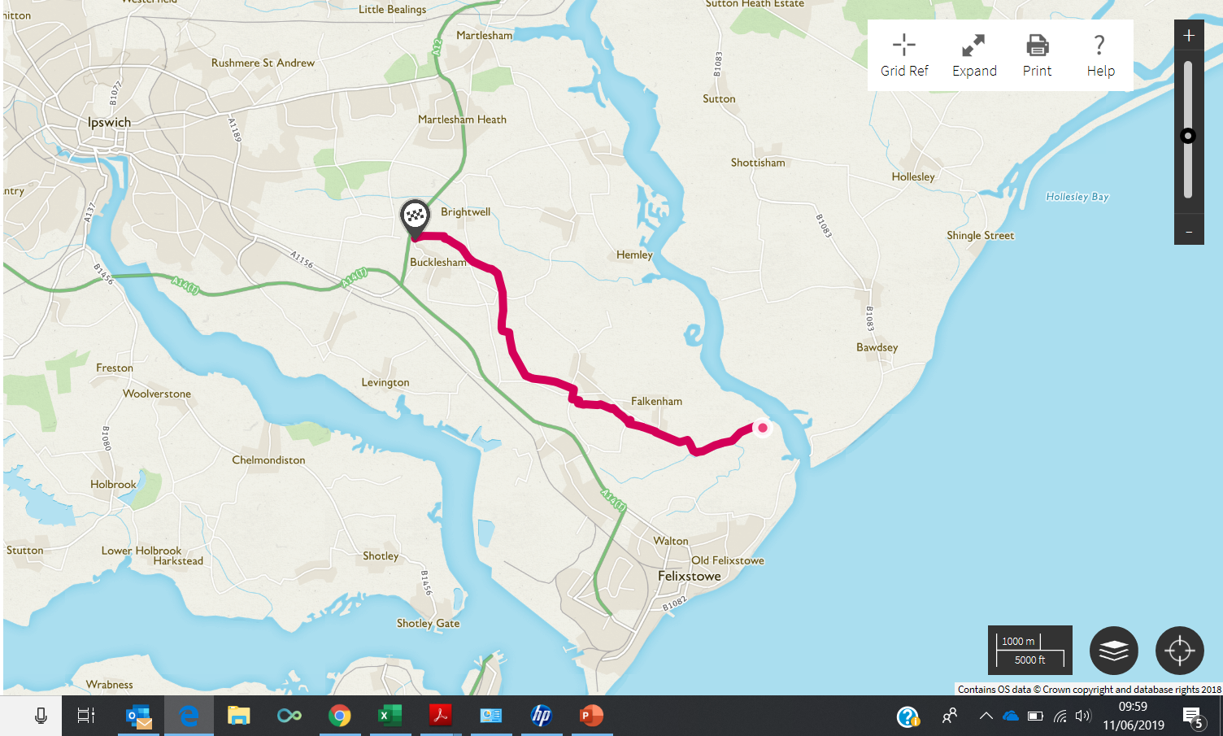


Slide 12
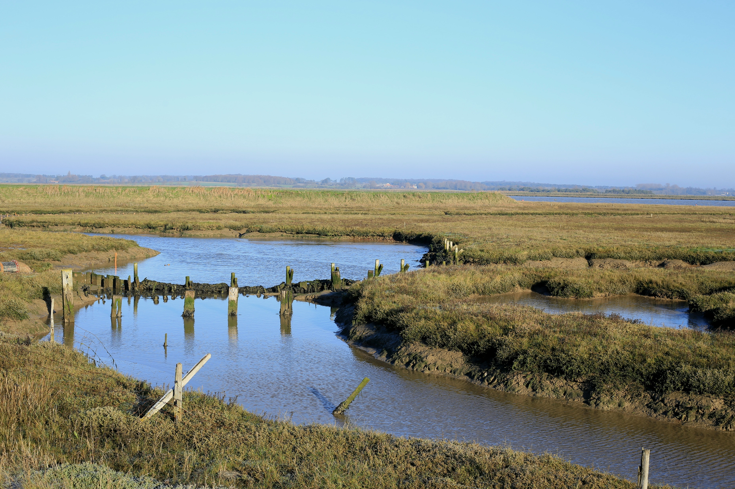
Environmental impact
Pumping of high volumes of drainage water into North Sea , 1,500,000 m3 p.a
Causes damage to valuable saltmarsh.
Working closely with IDB , this volume and associated damage now reduced.
Lower and less intense pumped volumes are still discharged to sea to provide freshwater in the estuary, to support wading birds and scenting for fish/eels.

Slide 13
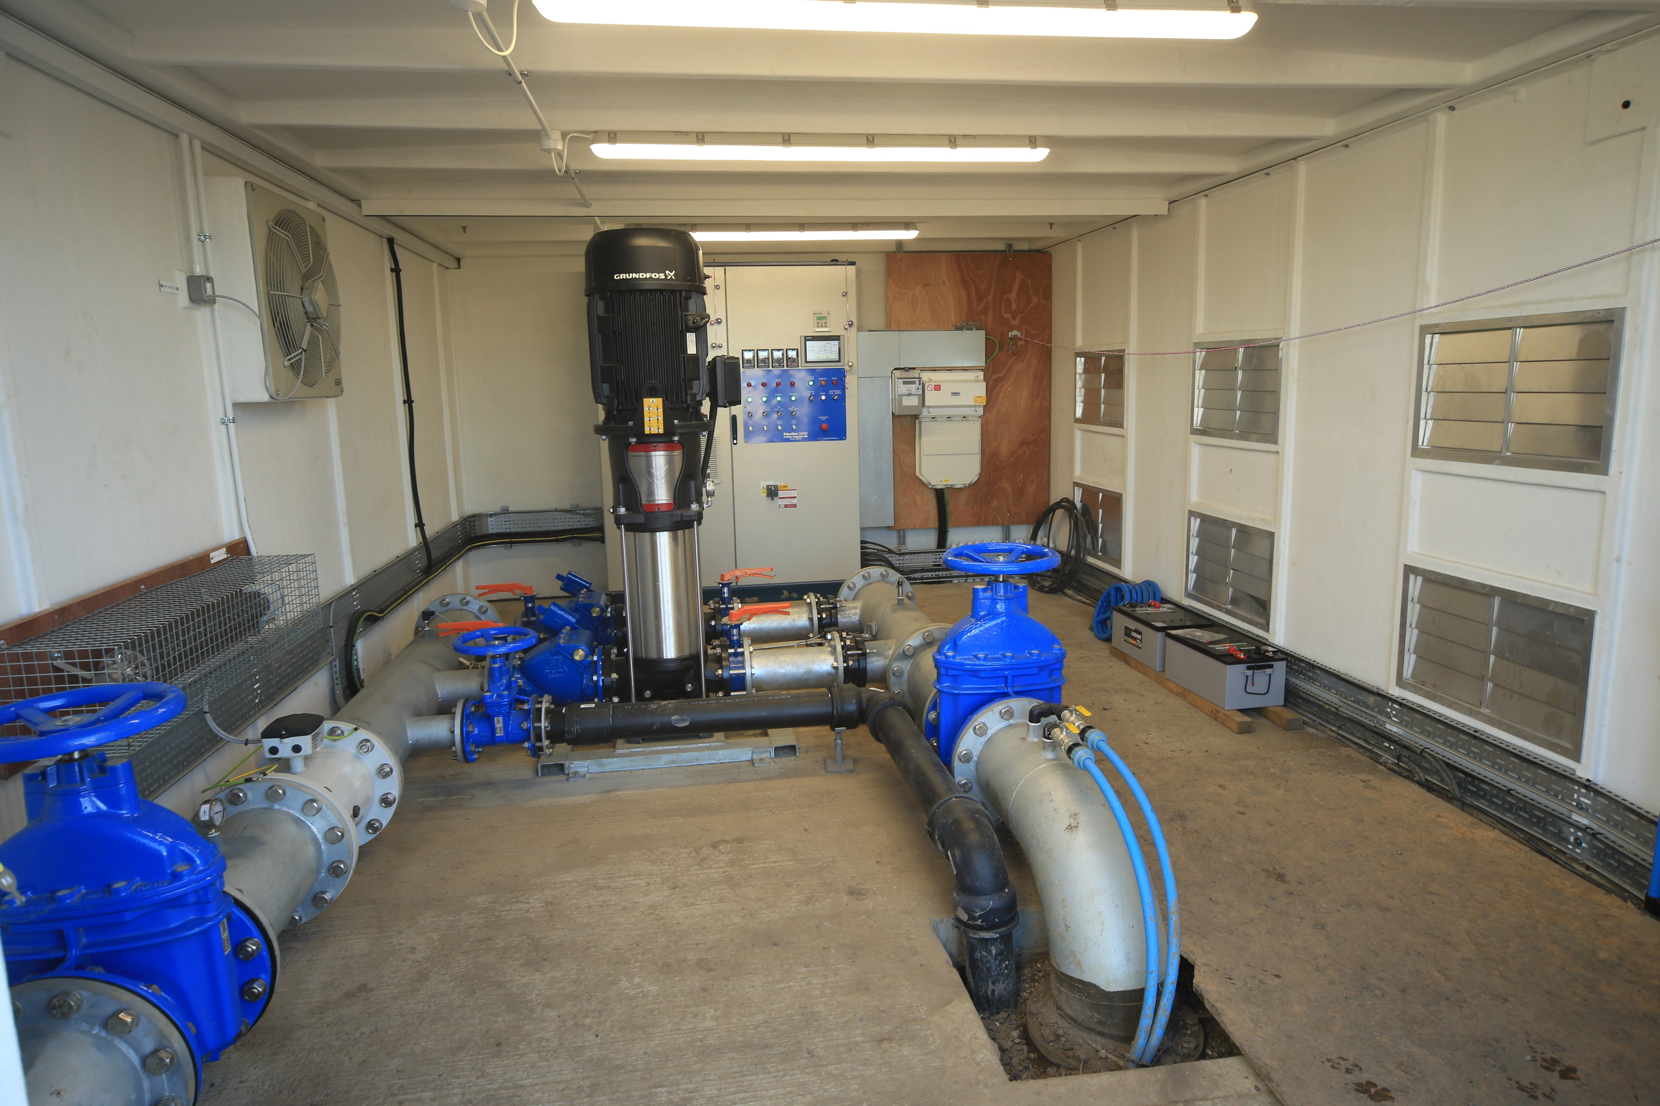
Pumping
600 ,000 m3 pumped annually back to farm reservoirs
2x eel friendly riverscreen pumps
2x 45 kW booster pumps operating at 12 bar
Flow rates of 236 m3/hr .
Remote control

Slide 14
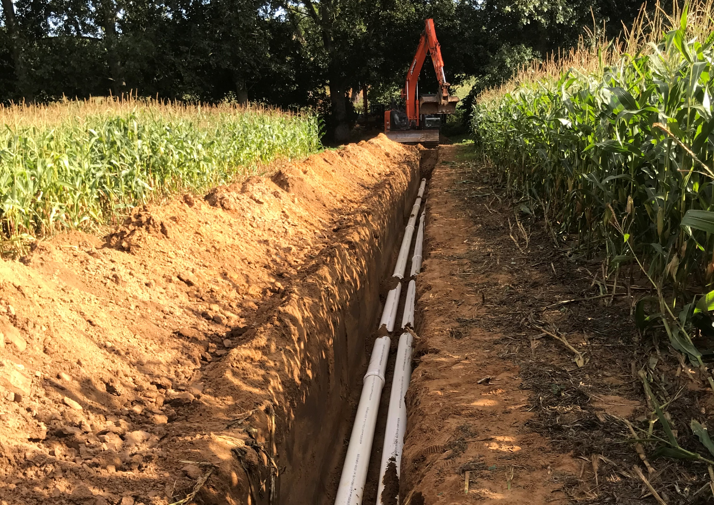
Pipeline
Avoids sensitive archaeology and environmental sites
2x 200mm pvc pipelines in a common trench
Supplying 9 different reservoirs up to 14 km inland.
Crossing 10 different land holdings.

Slide 15
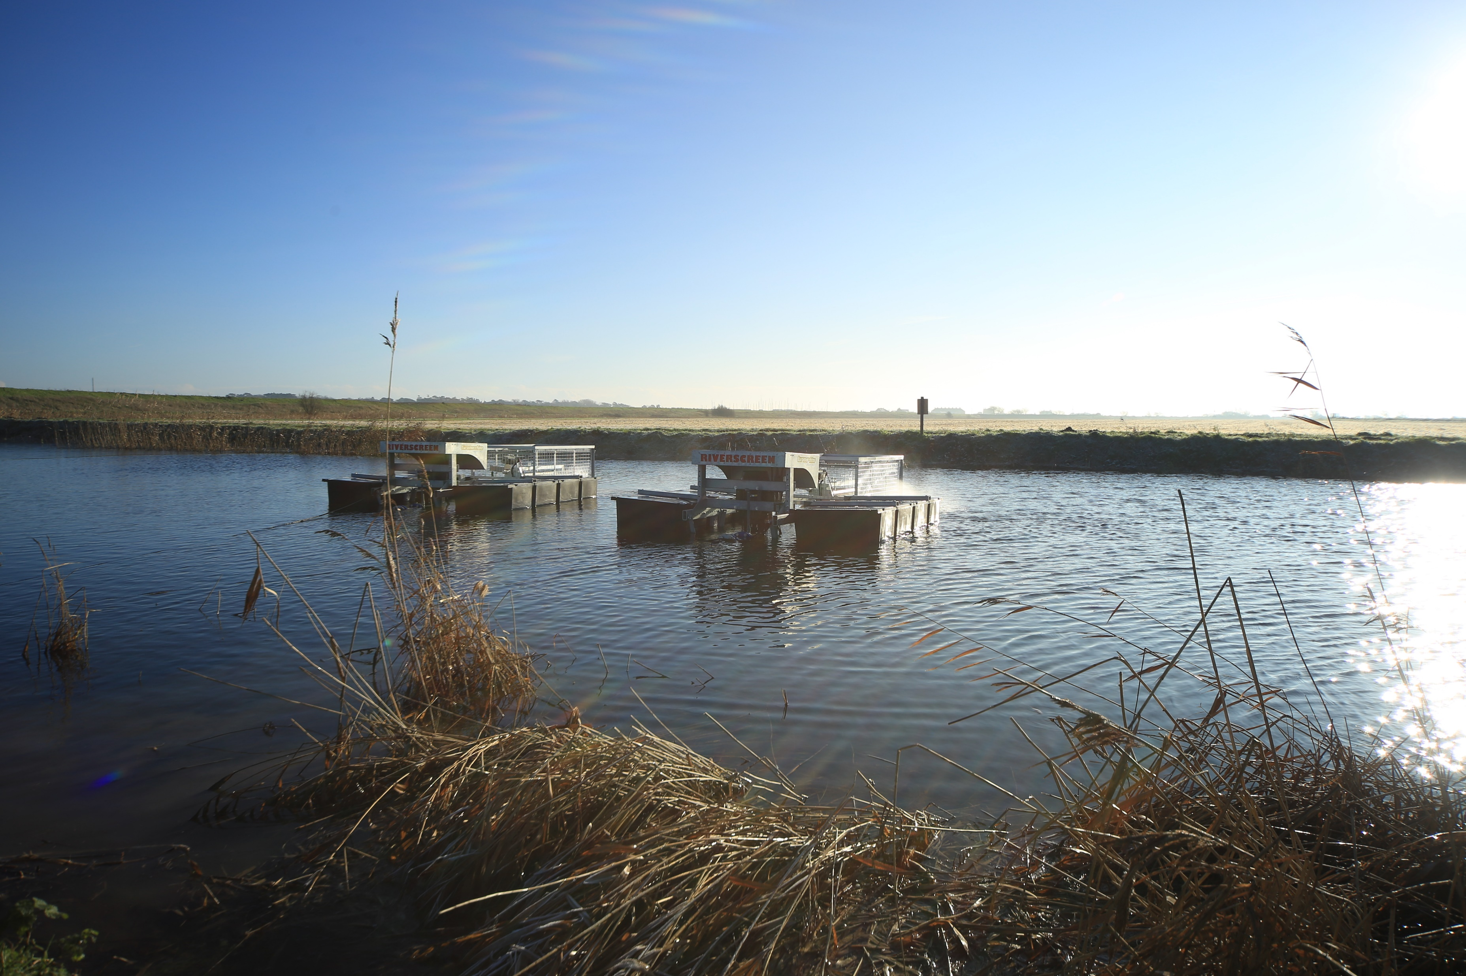
Funding
6 co-operating farmers, formed a limited company.
50% EU grant for capital FRESH4C’s
50% Match funding loans from members proportional to usage.
Members pay 20p/m3 for water delivered to their reservoir. This covers the running costs and also repays their loans in 14 years.

Slide 16
Managed Aquifer Recharge (MAR) Trial
The aim: to evaluate MAR as an alternative to reservoir storage.
Purpose: To use natural underground aquifer storage, rather than build reservoirs.
The challenges:
Source water quality suitable to meet the standards required by EA.
Getting the water into the ground/aquifer.
Proving that the water stays there.
Getting the water out of the again !
Outcome:
To demonstrate a fully operational system that the EA can licence
To provide a “road map” to help develop commercial MAR schemes in the future.

Slide 17
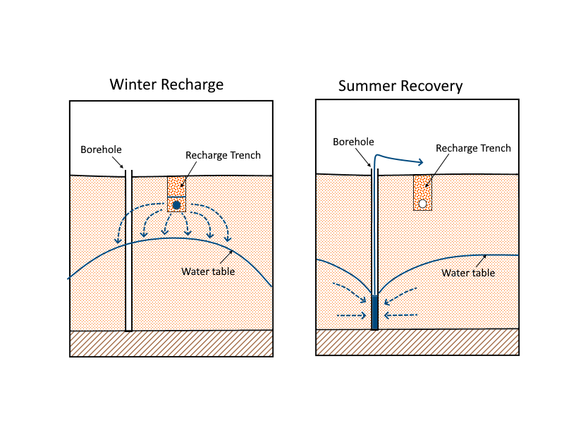
Managed Aquifer Recharge and Abstraction Trial
Recharge 15,000m³ April
500m of reverse land drainage
Re-Abstraction 15,000 May July
2 boreholes
Two Key Questions for the EA
  Quantity
  Quality (aquifer protection)

Slide 18
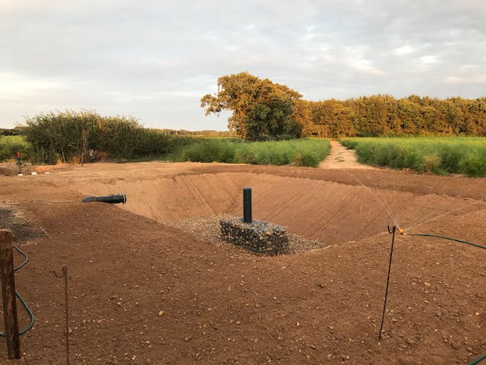

Slide 19
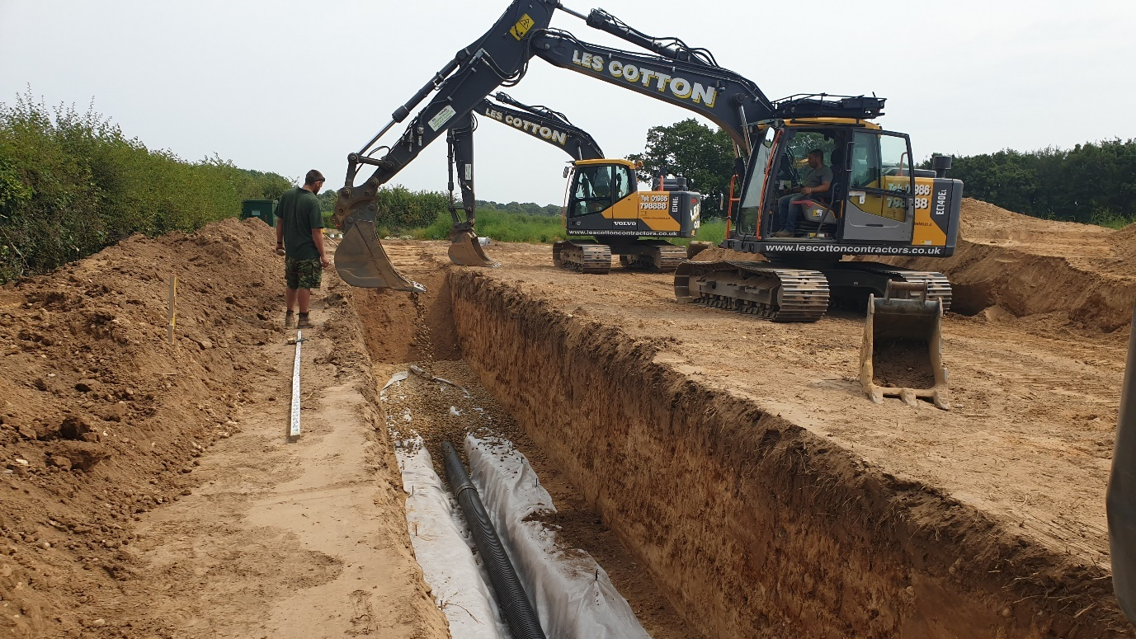

Slide 20
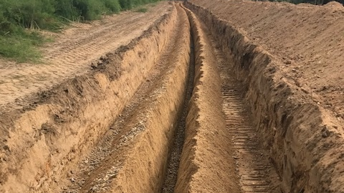

Slide 21
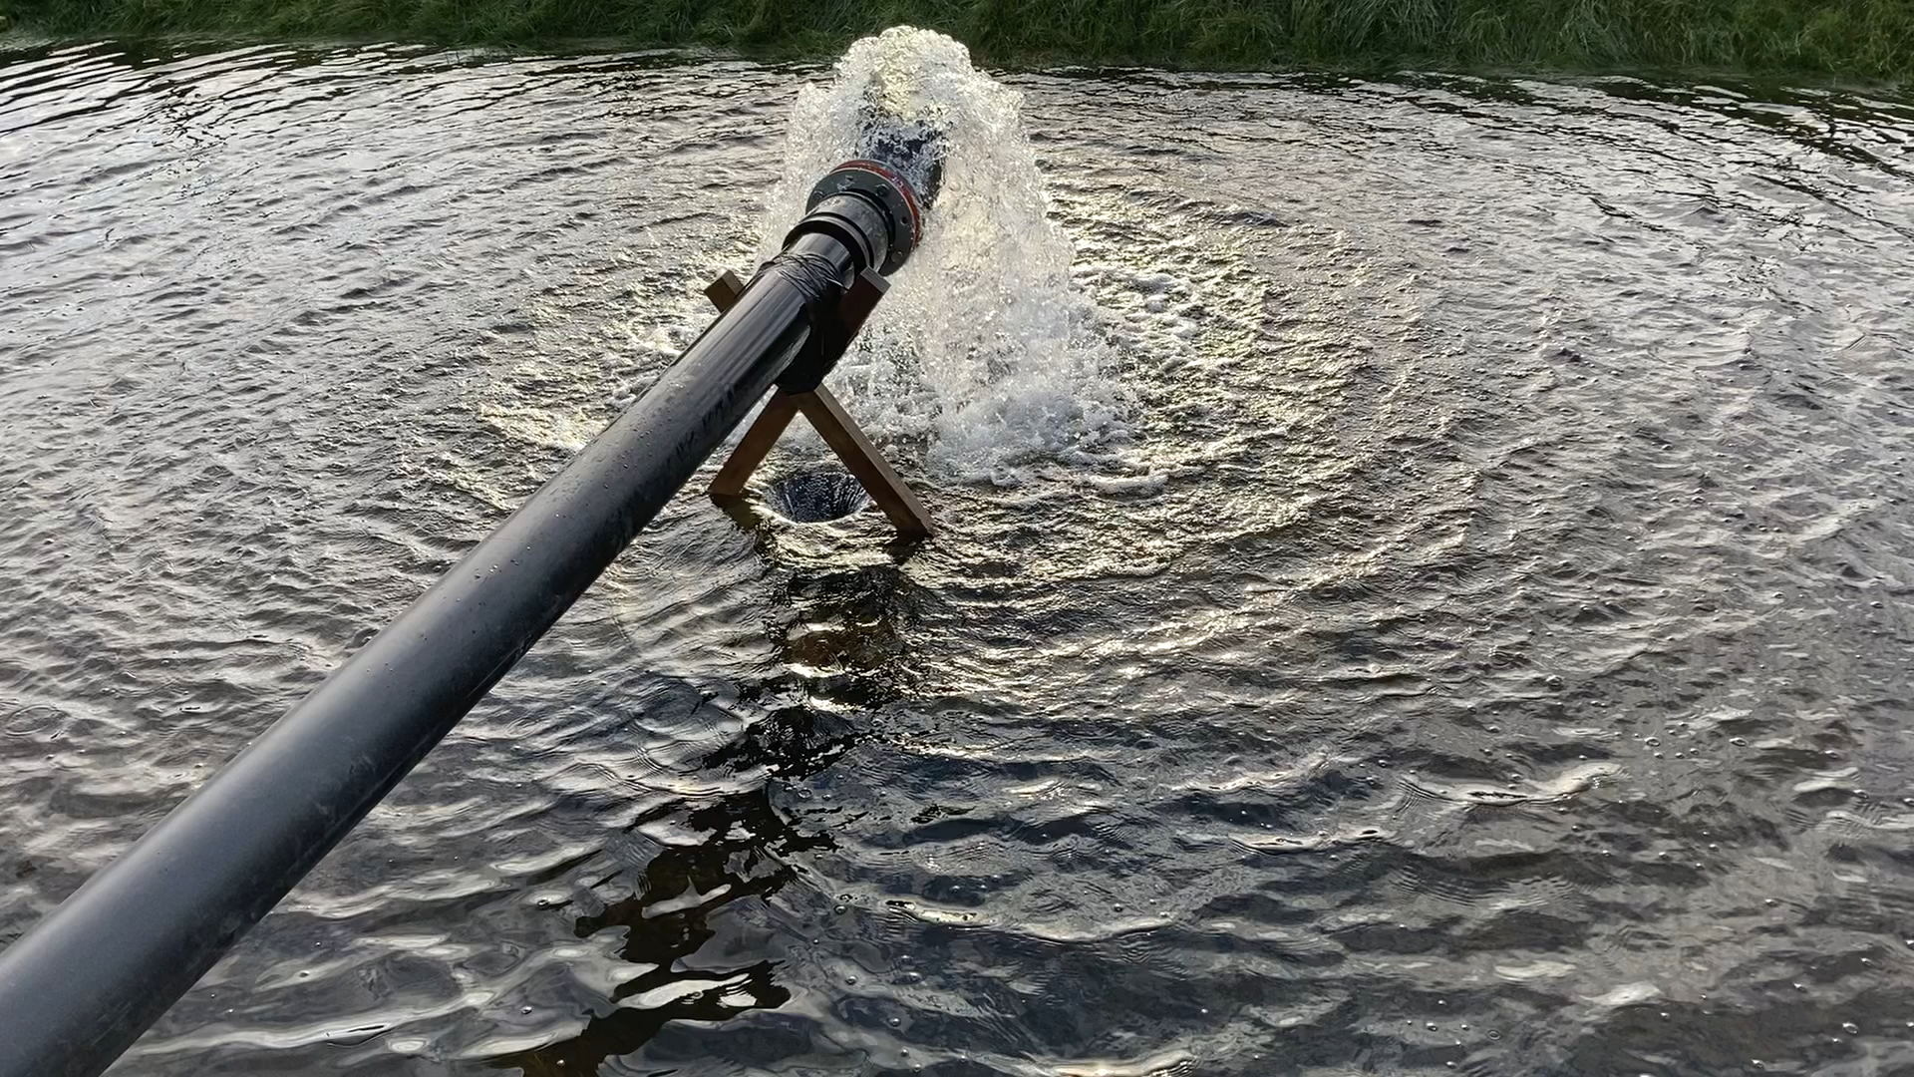

Slide 22
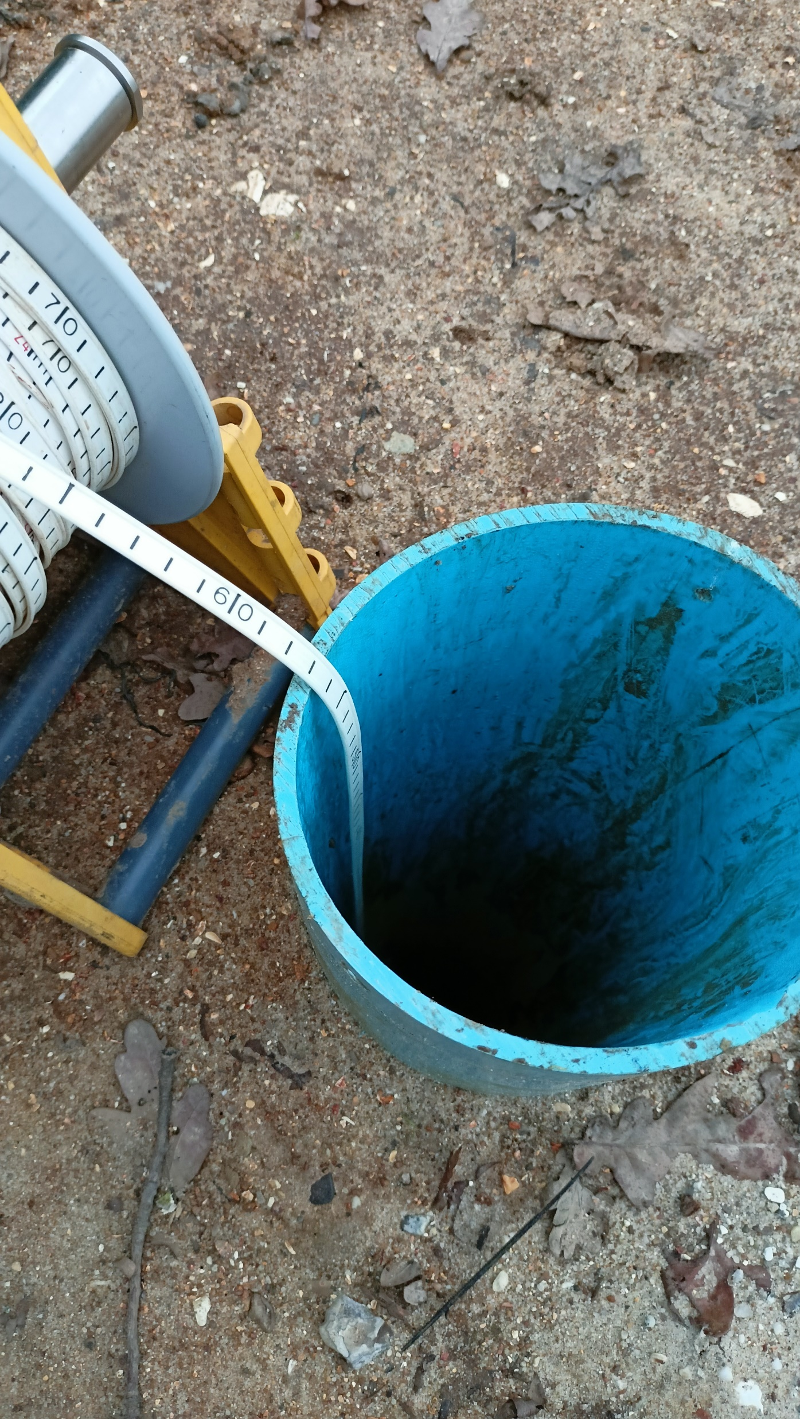
MAR Initial Test Summary
Aquifer recharge good at 1,000m3 day.
Abstraction rate disappointing at 100m3 day.
Initial results suggest water is staying in aquifer, this needs to be confirmed with trial.
Water Quality - 590 compounds tested OK
Chloride?
NB. Full results from MAR project and 4 other projects running with Dutch and Belgian partners, to be presented at FRESH4C’s open day on the sea wall on 9th & 10th June 2022.

Slide 23


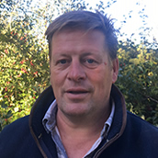
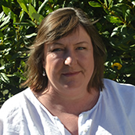

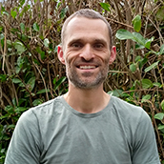
Thank you for listening
Sara Benstead
sara@swsllp.co.uk
John Patrick
john@swsllp.co.uk
Paul Bradford
paul@swsllp.co.uk
Mark Andrews
mark@swsllp.co.uk

