Slide 1
Farming: Clean, lean, green
Session 1: Improving hi-tech innovation in agriculture
Releasing the potential of data
11th May, 2022
Julian Gairdner – CCO, Map of Ag

Slide 2
A BIT OF BACKGROUND…
Map of Ag incorporated 2015
Precision Decisions acquired 2018
Rezare Systems acquired 2020
~125 people
(UK & NZ)
Precision Prospecting acquired 2016
Evidence Group acquired 2018

Slide 3

WHAT’S DRIVING THE DEMAND FOR DATA?
NEEDS
Provenance & traceability
Productivity
Health & welfare
GHG & carbon
Assurance & environmental planning
Public money for public goods
TECH
Computational power
Cloud computing
Machine Learning and AI
Satellite data and GPS
Device ubiquity

Slide 4


BUT TO INNOVATE WE NEED TO…
Turn this…
Into this…

Slide 5
DATA SHARING
Code of Practice research
2018
80 organisations consulted F2F
200 farmers responded to online survey
Benefits from sharing data must be demonstrable
Moral obligation to respect farmers’ “ownership” of their data
Farmers should be able to control where, how and by whom their data is used
Actionable insights preferred to “money for data”

Slide 6
DATA SHARING
Development of the code focused on…
Trust – ensuring farmers’ data is accessed, shared, stored, used and developed in a secure environment where there is transparency as to its ownership, use and impact
Legal – making sure that data flows are backed by a legal framework that supports trust and transparency
Technical – creating an ecosystem of aligned approaches that allow data to pass between permissioned entities in a frictionless way

Slide 7

WHEN IT COMES TO DATA TRUST IS #1

Slide 8
THE CHALLENGES WITH FARM DATA
Fragmented – bitty and incomplete
Heterogeneous – non-standardised and incompatible
Varying quality – rubbish in = rubbish out!
Conflicting – what’s the source of truth?
Often hard to reach – old/legacy systems; non-cloud; poor rural connectivity

Slide 9
OPPORTUNITY FOR INNOVATION
Gains from data are potentially enormous…
“If [rural] connectivity is implemented successfully in agriculture, the industry could tack on $500 billion in additional value to the global gross domestic product by 2030, according to our research.”
Agriculture’s connected future: How technology can yield new growth | McKinsey October, 2020

Slide 10



PURE FARMING – A DATA TECHNOLOGY SUITE
REAL TIME
Convenient, permissioned, organised access to hard-to-reach farm data insights to build customer trust
RISK & COST REDUCTION
Insights that allow risks to be mitigated and efficiencies to be realised
CHANGE
Using data science to demonstrate cause and effect and partnering with suppliers to make improvement such as working towards net zero
INDUSTRY BENEFITS
CONVENIENCE
I can bring all my data into one place where I can permission access to trusted third parties
CONTROL
I can control where my data goes and under what conditions
ACTION
I can receive insights from my data or have it help me with meeting compliance, assurance and sustainability targets or requirements

Slide 11
PURE FARMING – A DATA TECHNOLOGY SUITE
Software
White-label analysis tools FarmMetrics and MiFarm to visualise and interpret data
Software Components
Pre-built for innovative applications using data from the integration pipeline
Models & Logic
Derived outputs and metrics from data permissioned via the integration pipeline
Data Integration
Ingest Cleanse Permission Provision Deliver

Slide 12
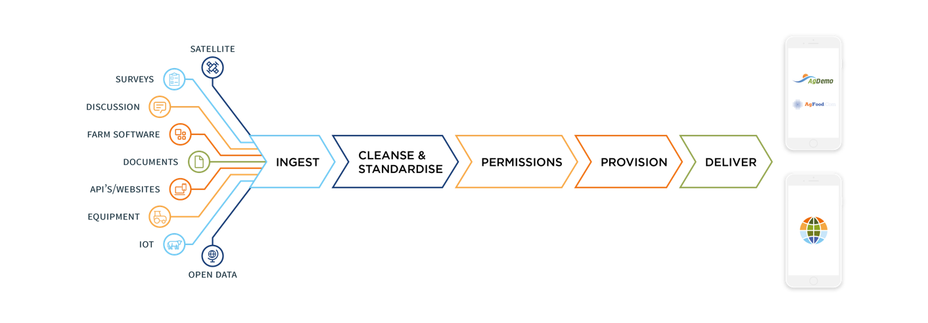

PURE FARMING – A DATA TECHNOLOGY SUITE
Data Integration
Ingest Cleanse Permission Provision Deliver
INGEST
CLEANSE & STANDARDISE
PERMISSION
PROVISION
DELIVER

Slide 13



PURE FARMING – A DATA TECHNOLOGY SUITE
Models & Logic
Derived outputs and metrics from data permissioned via the integration pipeline
…and others

Slide 14
PURE FARMING – A DATA TECHNOLOGY SUITE
Software Components
Pre-built for innovative applications using data from the integration pipeline
Coming soon!

Slide 15


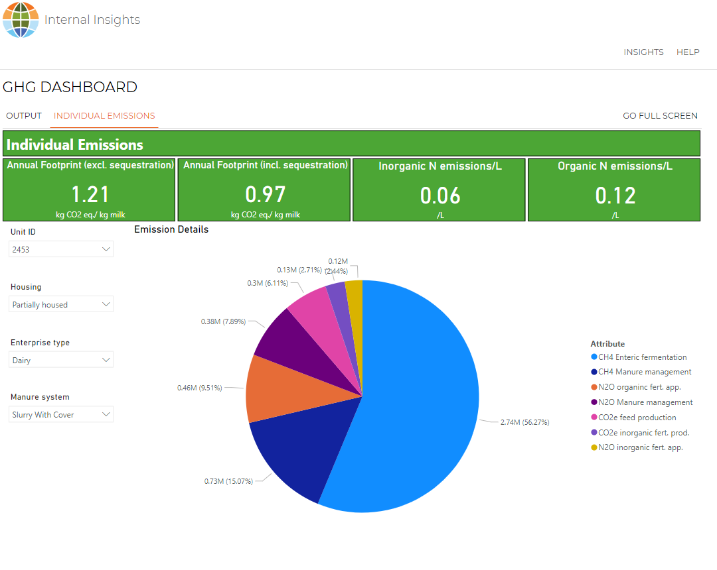
PURE FARMING – A DATA TECHNOLOGY SUITE
Software
White-label analysis tools FarmMetrics and MiFarm to visualise and interpret data

Slide 16









PURE FARMING – POWERING UP INNOVATION (an example)
Farm-scale data
Modelling
Results Presentation
Knowledge Transfer
  Integrate with multiple data sources to improve consistency and accuracy of data
  Cleanse and standardise to improve interoperability
  Populate the most appropriate models to generate GHG analysis
  Data dashboards
  Key Performance Indicators
  Data-led advice influencing change
  Measuring improvements

Slide 17
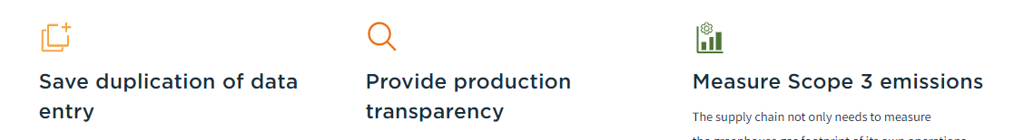

PURE FARMING – EXAMPLE USE CASES FOR INNOVATION

Slide 18



POWERING YOU UP
FARMER
DATA
INSIGHTS &
INNOVATION

Slide 19
POWERING YOU UP
THANK YOU

