Slide 1

Whole energy approach
Stephen Ramm

Slide 2

‘A whole energy approach’ means developing a portfolio of options for clean energy in all its various uses (electricity, heating and transport), and crucially by fitting them together in the best combinations to deliver value for business
Notes:
Thanks for coming along today to discuss the energy approach
The reason I wanted to take this ooprtunity

Slide 3
Energy has become incredibly diverse*
*and difficult to manage
Green Levies
Intermittency
Rising wholesale costs
Geo-political tensions
Energy for most of us will be in the form of liquid, gas or electricity.
All these products have increased in price due to many different reasons over the past several years
Notes:
Energy – we all need it for various processes like getting up in the morning (I find coffee helps quite a bit as well)
All the way through to providing space heating and running large pumps for irrigation.
Fact is we simply cannot manage without it and it generally is a finite resource
As we have come to accept this fact we have had to int
Simple times
Needed heat throw a log on the fire,
The end result is Energy has become incredibly diverse and the small print nobody mentioned was that it would be difficult to manage and sometimes quite expensive!

Slide 4
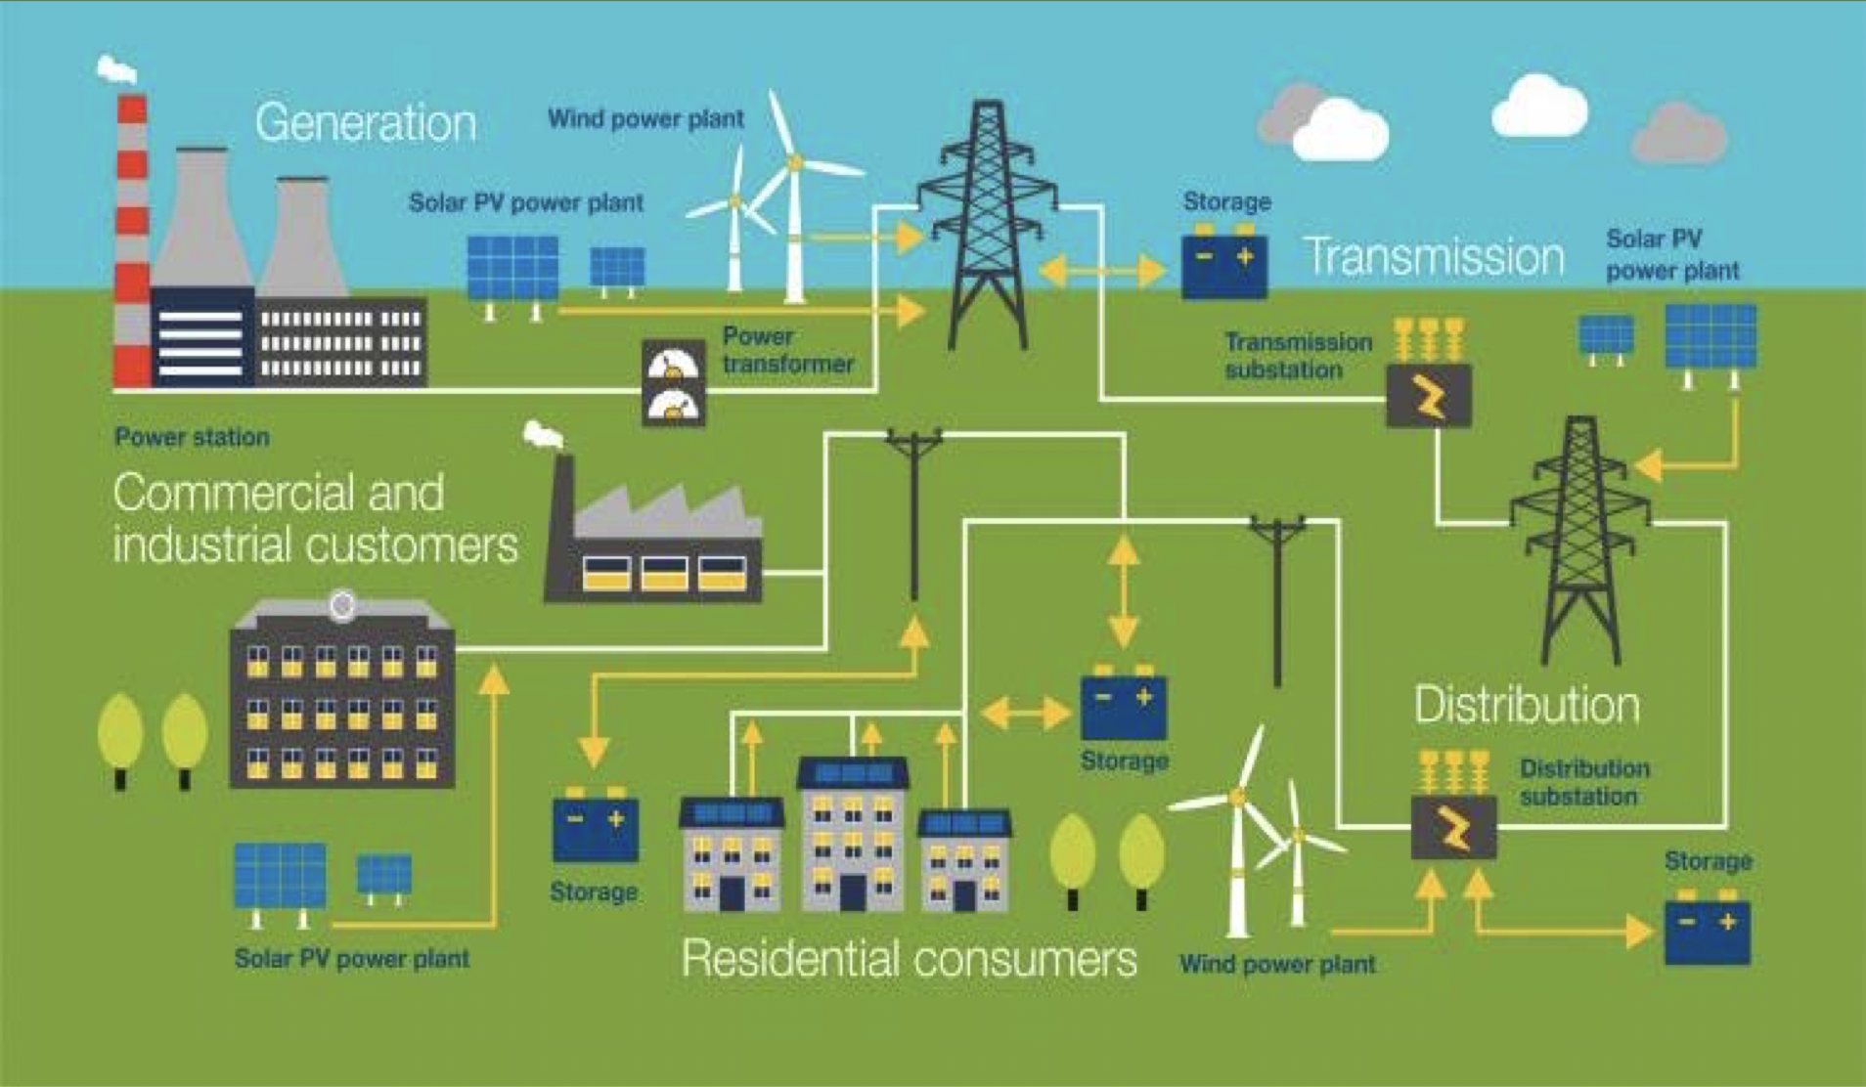
Notes:
Now for the sake of this presentation I am going to focus on one of the bigger areas Electricity! Its something that we are all being pushed towards when we talk of decarbonization. Gas, Diesel, Gas oil, Kerosene, timber - wood pellets etc have even seen some complexity with new regulations being introduced Sorry for quality I hope you can all see this infographic kindly supplied by National Grid
It gives some of the idea of the complexity of our current system – this is the simple version because actuallywe can add more to this via interconnects to other countries.
This will only get more complex when we add in a greater roll of of Electric vehicles and the storage and change of demand in system

Slide 5
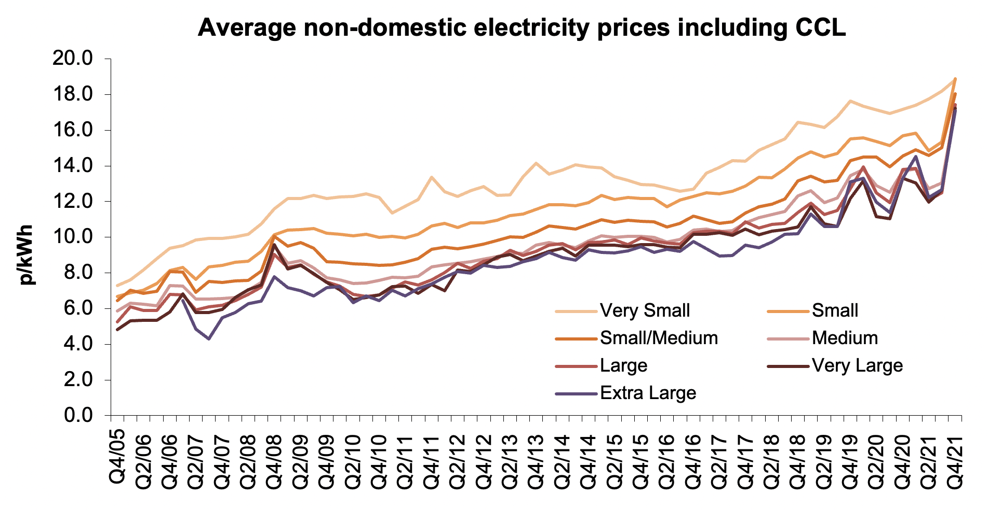
What has this meant for businesses?
Data supplied by BEIS March 2022

Slide 6
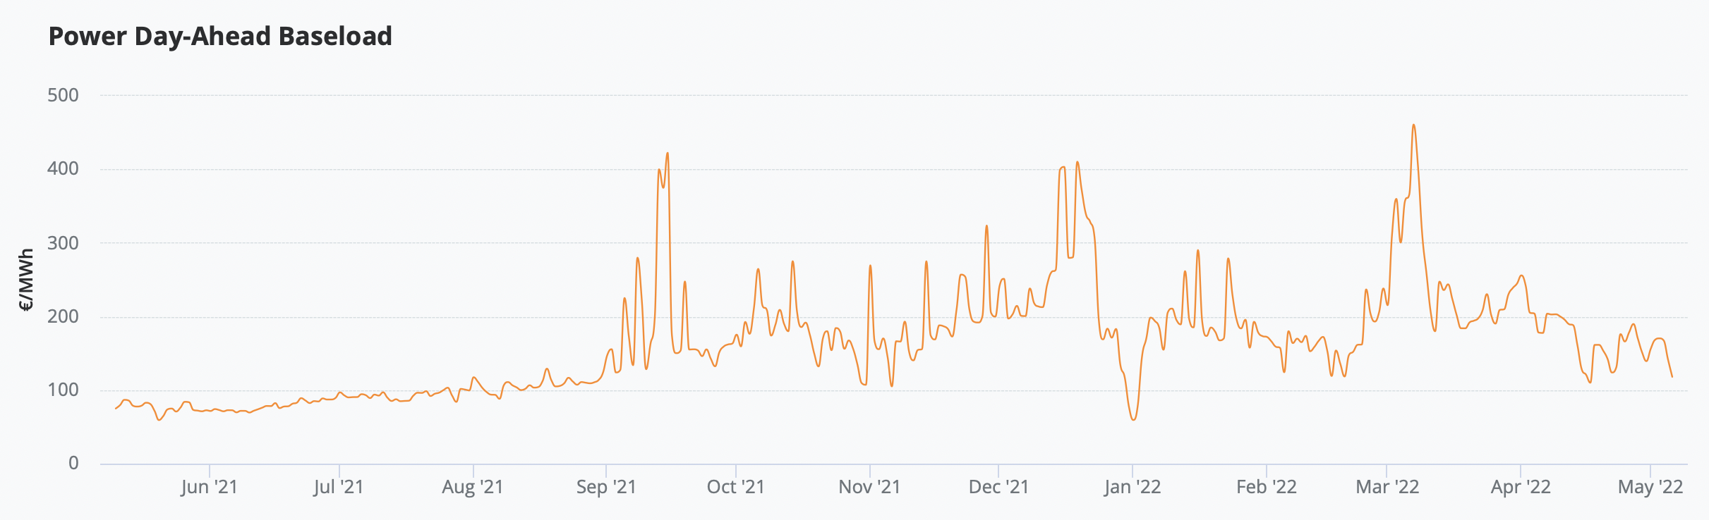
Market Volatility
Notes:
This volatility has to be accounted for in our energy bills.

Slide 7
Example of Potato store site
Other site constraints to consider:
export agreement, take or pay clauses, shared supplies, future plans, EV rollout, other fuel sources e.g mains gas (co-generation)

Slide 8
As systems become more diverse and more complex it becomes vital to consider your whole strategy before taking any action in isolation

Slide 9
Step 1
Procurement
What your business is already buying to keep going
Step 2
Metering
How are you quantifying the energy you pay for and what data is available
Step 3
Energy efficiency
Once we have established a solid baseload how can we reduce the consumption
Step 4
Self generation
Once we have explored all other areas, we can start to look at generating your own power on site
Notes:
for the entire business to include future plans.
Don’t get too narrow visioned
What your business is already buying to keep going
How are you quantifying the energy you pay for and what data is available to create an accurate picture of whats happening
Once we have established a solid baseload how can we reduce the consumption
Once all other areas have explored we can start to look at generating some of your own power on site

Slide 10
Dairy farmer, 100 kWp solar array Wanted to expand system as his bills had not been reduced
Default MOP contract in place (metering & procurement)
Issues with estimated data (metering)
No actual export connection agreement in place with DNO (Self generation)
Giving power back to the system FOC (procurement)
String fault on inverter identified through simple cross check of inverter totals (energy efficiency)

Slide 11
At first glance when we resolved the other issues it was evident that there was spare power being exported back to the system
The inevitable question was should we store this power on site for use later in the day?
The client milked three times daily so there was plenty of consumption outside normal SPV generation times. However, with energy markets so high at the present time a higher value Power Purchase Contracts (PPA’s) made better financial sense.

Slide 12
These four methods work across all energy types and should form the basis of any effective energy strategy
If an effective strategy is introduced
Taking account of every aspect of the business
And the system is well designed
We should be able remove or reduce the need for additional items such as onsite battery storage!

Slide 13
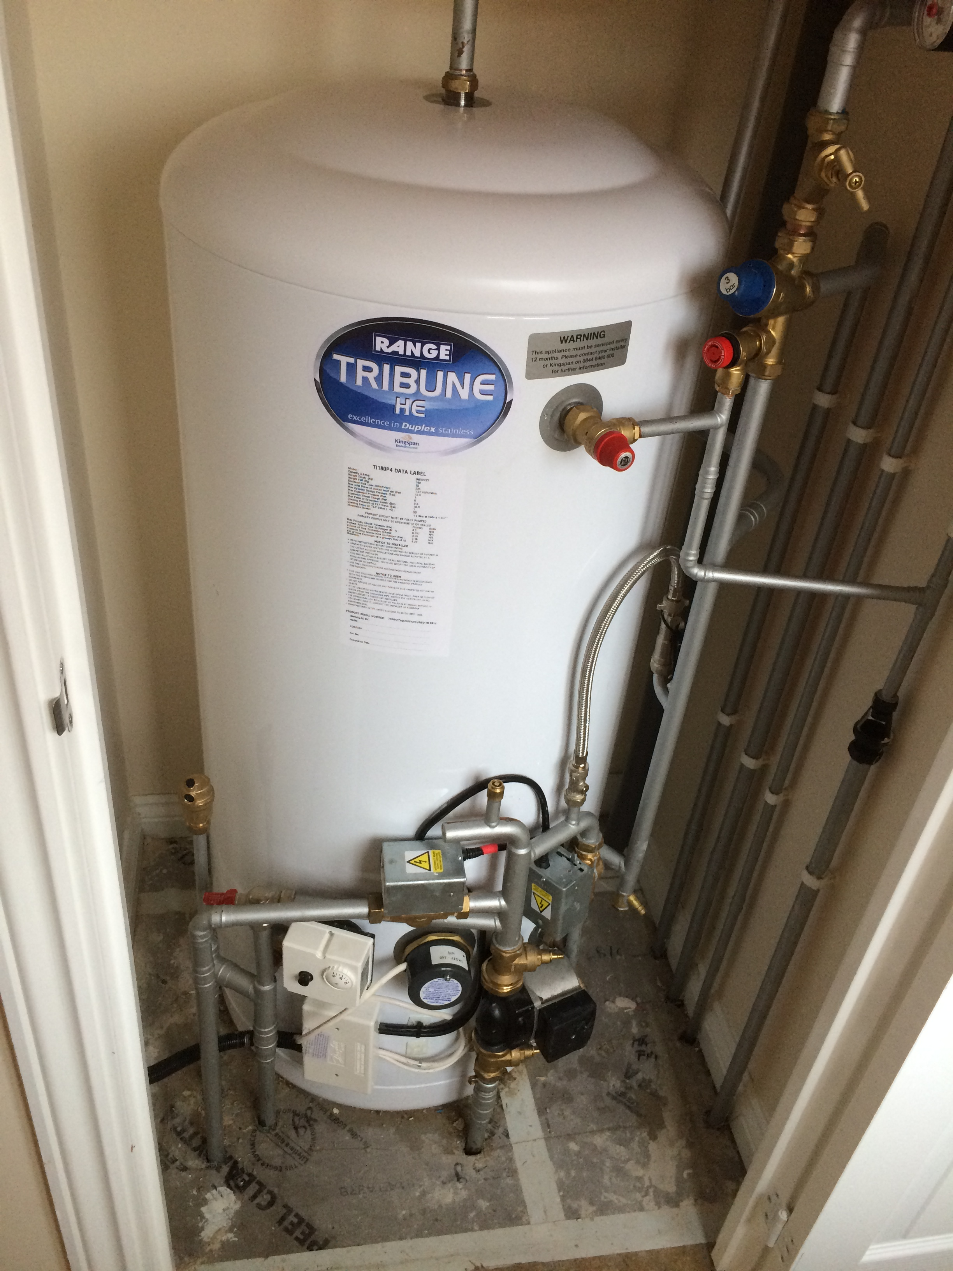
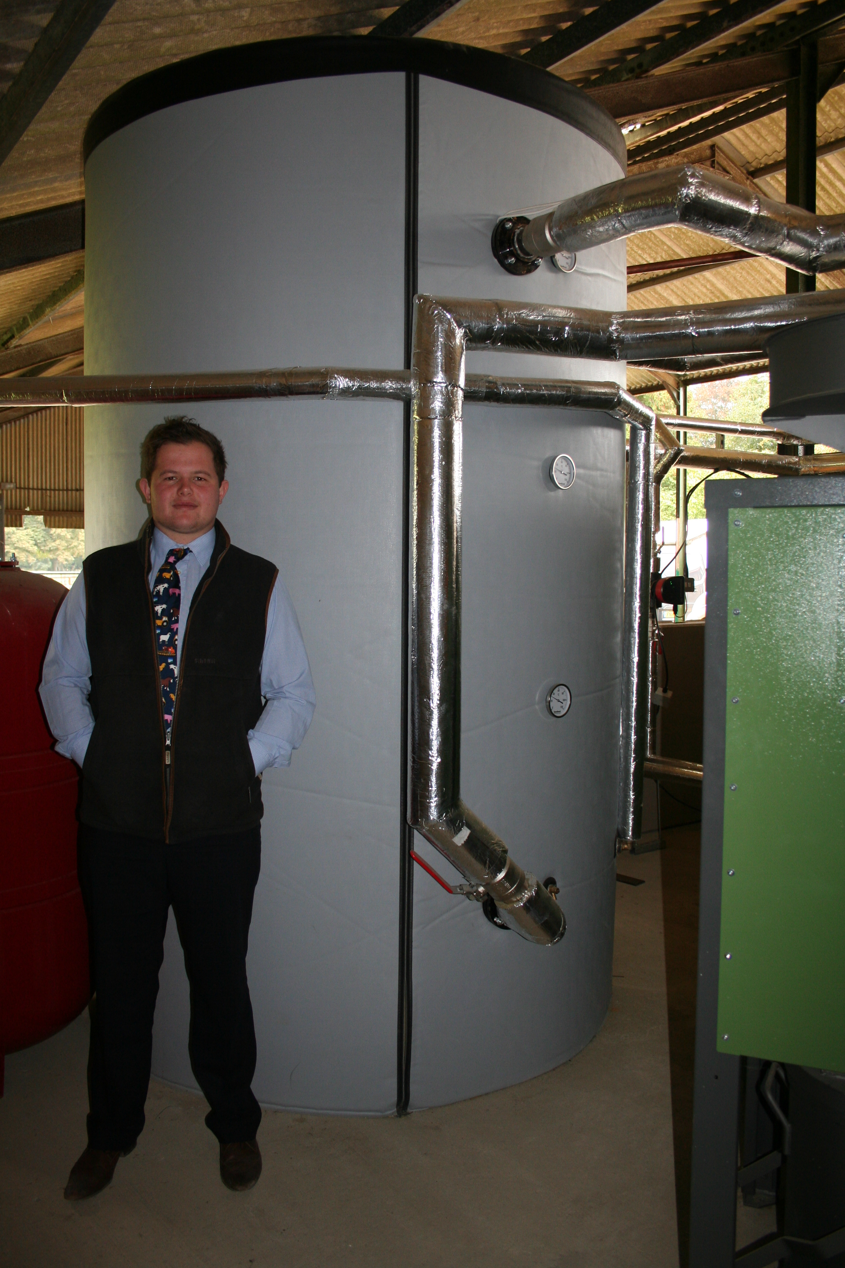
Batteries certainly have their place but only as part of a full energy strategy
Examples of other options:
Alternative forms of storage
Thermal energy
Hot water & cooling loads
Electric Vehicles
Load shifting
Behavioral change
Using power at different times
Process change
Pumping water at different times
Technology change
Heat pumps

