Slide 1
Environment and Resource Management: case studies from LEAF
The Clean Air Day, Park Farm
Wednesday 11th May
Will Sibly MSc
will.sibly@leaf.eco
Notes:
Thanks for inviting me
Nature – the more I find out the more I realise things I don’t know. Farming and wider industries that drive our societies rely on nature
I’m here today to go over what LEAF does, how it is an enabler for driving positive natural environment and resource management in farming and show a few case studies from projects were have been doing *One of which Park Farm has been involved in

Slide 2
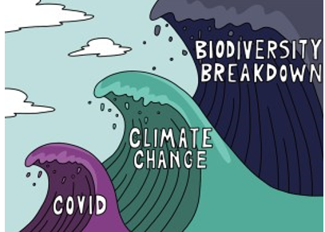
Notes:
Tidal waves disasters that are bringing big challenges. +Fert, fuel and connections with the very complex food and global system, which is heavily embedded and not easy to change. Like waves breaking, things go up and down in public eye.
Farmers increasing battling with climate (drought, rain, wind). In UK, could be an advantage? New crops and yields from carbon atmosphere, but also new pests. We just don’t know how things are going to go.
Biodiversity is a resource for farmers, and it has declined!
HIGHLIGHTS
Earth’s temperature has risen by 0.14° F (0.08° C) per decade since 1880, and the rate of warming over the past 40 years is more than twice that: 0.32° F (0.18° C) per decade since 1981.
2020 was the second-warmest year on record based on NOAA’s temperature data, and land areas were record warm.
Averaged across land and ocean, the 2020 surface temperature was 1.76° F (0.98° Celsius) warmer than the twentieth-century average of 57.0°F (13.9°C) and 2.14˚F (1.19˚C) warmer than the pre-industrial period (1880-1900).
Despite a late-year La Niña event that cooled a wide swath of the tropical Pacific Ocean, 2020 came just 0.04˚ Fahrenheit (0.02˚Celsius) shy of tying 2016 for warmest year on record.
The 10 warmest years on record have occurred since 2005.
From 1900 to 1980 a new temperature record was set on average every 13.5 years; from 1981–2019, a new record was set every 3 years.
“The Living Planet Index is one of the most comprehensive measures of global biodiversity. An average decline of 68 percent in the past 50 years is catastrophic, and clear evidence of the damage human activity is doing to the natural world,” said Andrew Terry, director of conservation at ZSL

Slide 3
Innovation
Water
Carbon
Shared values
Soil
Biodiversity
Notes:
Lots of changes going on to address these challenges and the wider food system that is now embedded with complexities.
The National Food Strategy, ELMs, innovation and research
It will come down to how, as an industry we management our environment and natural resources.
Soil is he lifeblood of the planet,

Slide 4

Three pillars of sustainability…
Notes:
30 years, the three pillars…
Where does LEAF come in?
One of many brilliant organisations adding to the drive in how to do things better.

Slide 5


LEAF 10 –Year Strategy
…our themes, our workstreams, our commitments
LEAF 10-Year Strategy eight commitments:
Delivering Climate Positive Solutions
Creating Beacons of Excellence
Measuring Impact and Harmonising Metrics
Building Sustainable Food Chains
Growing Education and Engaging Society
Cultivating Sustainable Health and Wellbeing
Building Connections
Scaling up Our Reach

Slide 6

Education & Engaging Society
Working to inspire and educate future generations & wider society about farming, food and the countryside.
Our Priorities:
To pursue excellence in education in farming, food and the countryside
To provide innovative and engaging activities and resources both in the classroom and on the farm
To raise the confidence of all teachers to deliver powerful learning experiences around food and farming
To equip, mobilise and increase the capability of farmers to deliver learning experiences.

Slide 7

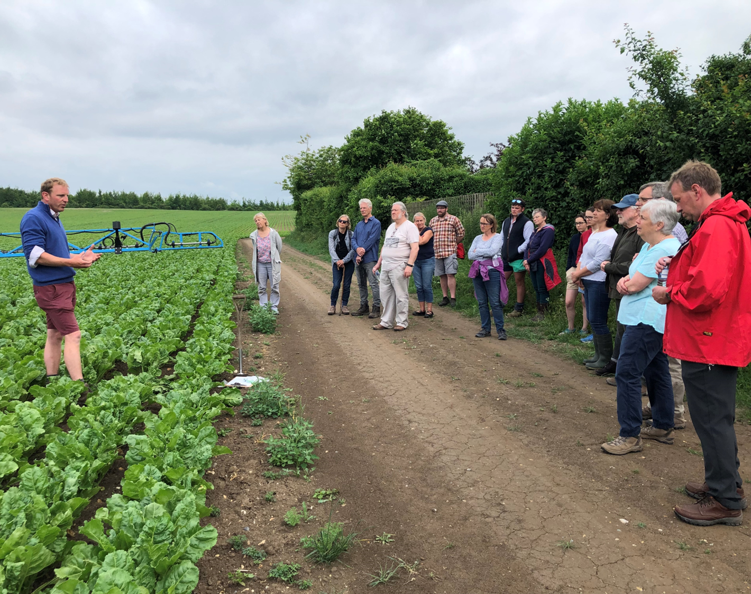
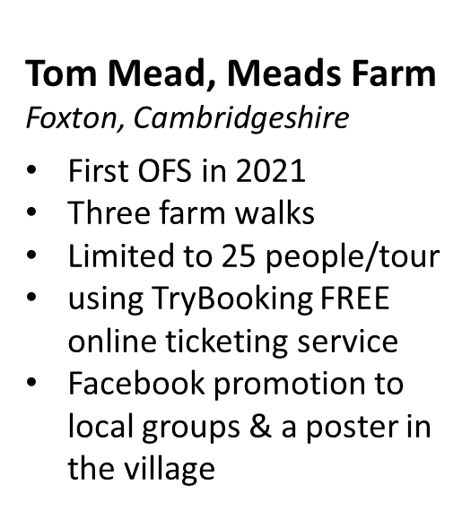
Notes:
Annabel, pictures….

Slide 8
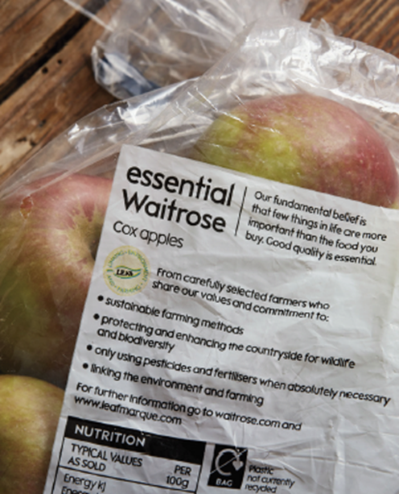


Developing Market Opportunities
LEAF Marque
Independent assurance system
Demonstrating environmental sustainability credentials
Whole farm and site specific
Global scheme and all farming types
Incorporating Outcomes Based Approach
ISEAL Alliance Code Compliant – Standard-Setting, Assurance, Impacts
Earned Recognition with Environment Agency
Notes:
Connection with consumer, who want sustainability
Applicable for all farm types and whole farm
ISEAL Alliance Code Compliant – fully impartial

Slide 9
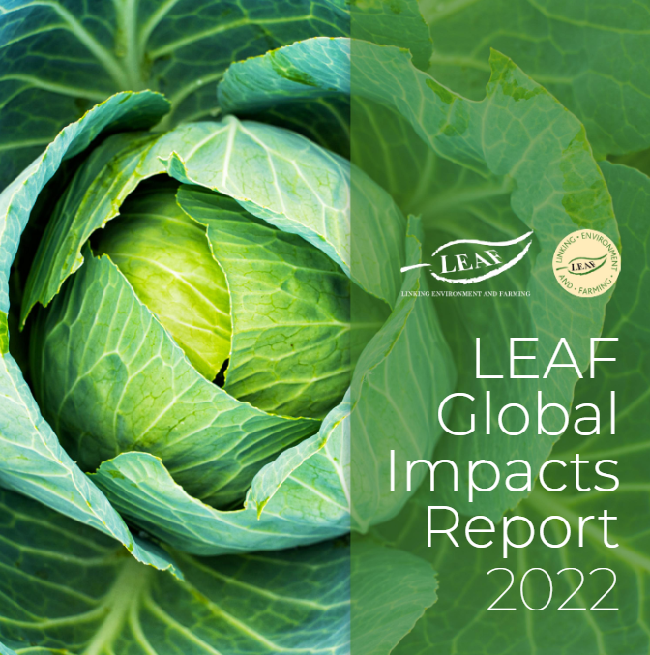
Driving impact
877 LEAF Marque certified businesses in 19 countries worldwide
Almost half (48%) of the UK’s fruit and vegetables are grown sustainably on LEAF Marque certified businesses
75% of LEAF Marque farms have one or more types of renewable energy generation and 44% use a carbon footprint tool
73% of LEAF Marque businesses have a general policy to increase soil organic matter with 46% recording soil organic matter and 50% optimising carbon capture and sequestration
LEAF Marque farms have an average habitat area of 15%
Notes:
Driven by consumers <> retailers <> LEAF Marque
Proud of these impacts, 48% of UK fresh produce is LEAF Marque.
Renewable energy and carbon footprinting
SOM and carbon capture
15% of biodiversity area

Slide 10
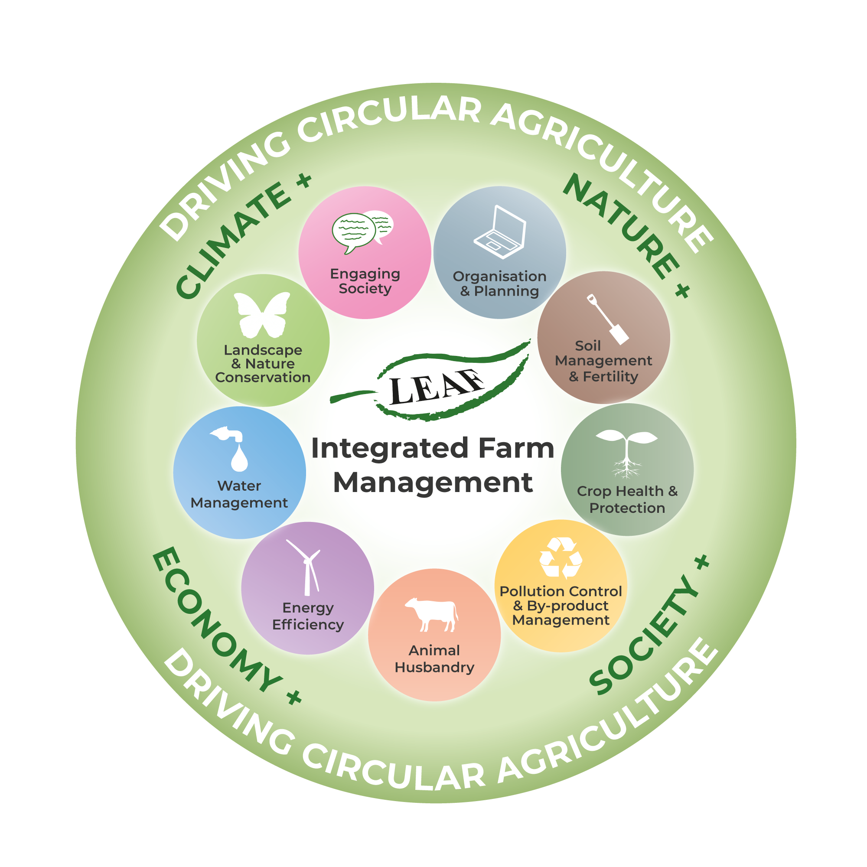
Integrated Farm Management
Whole farm and site specific
Continuous improvement
Aids delivery of sustainable farming practices
Enables measurement
Notes:
Applicable to all types and whole farm – important! Inclusive and support all sectors in the industry.
Some sectors have a more difficult time in the noise around farming and the environment, so it’s important to give the medium to them.

Slide 11
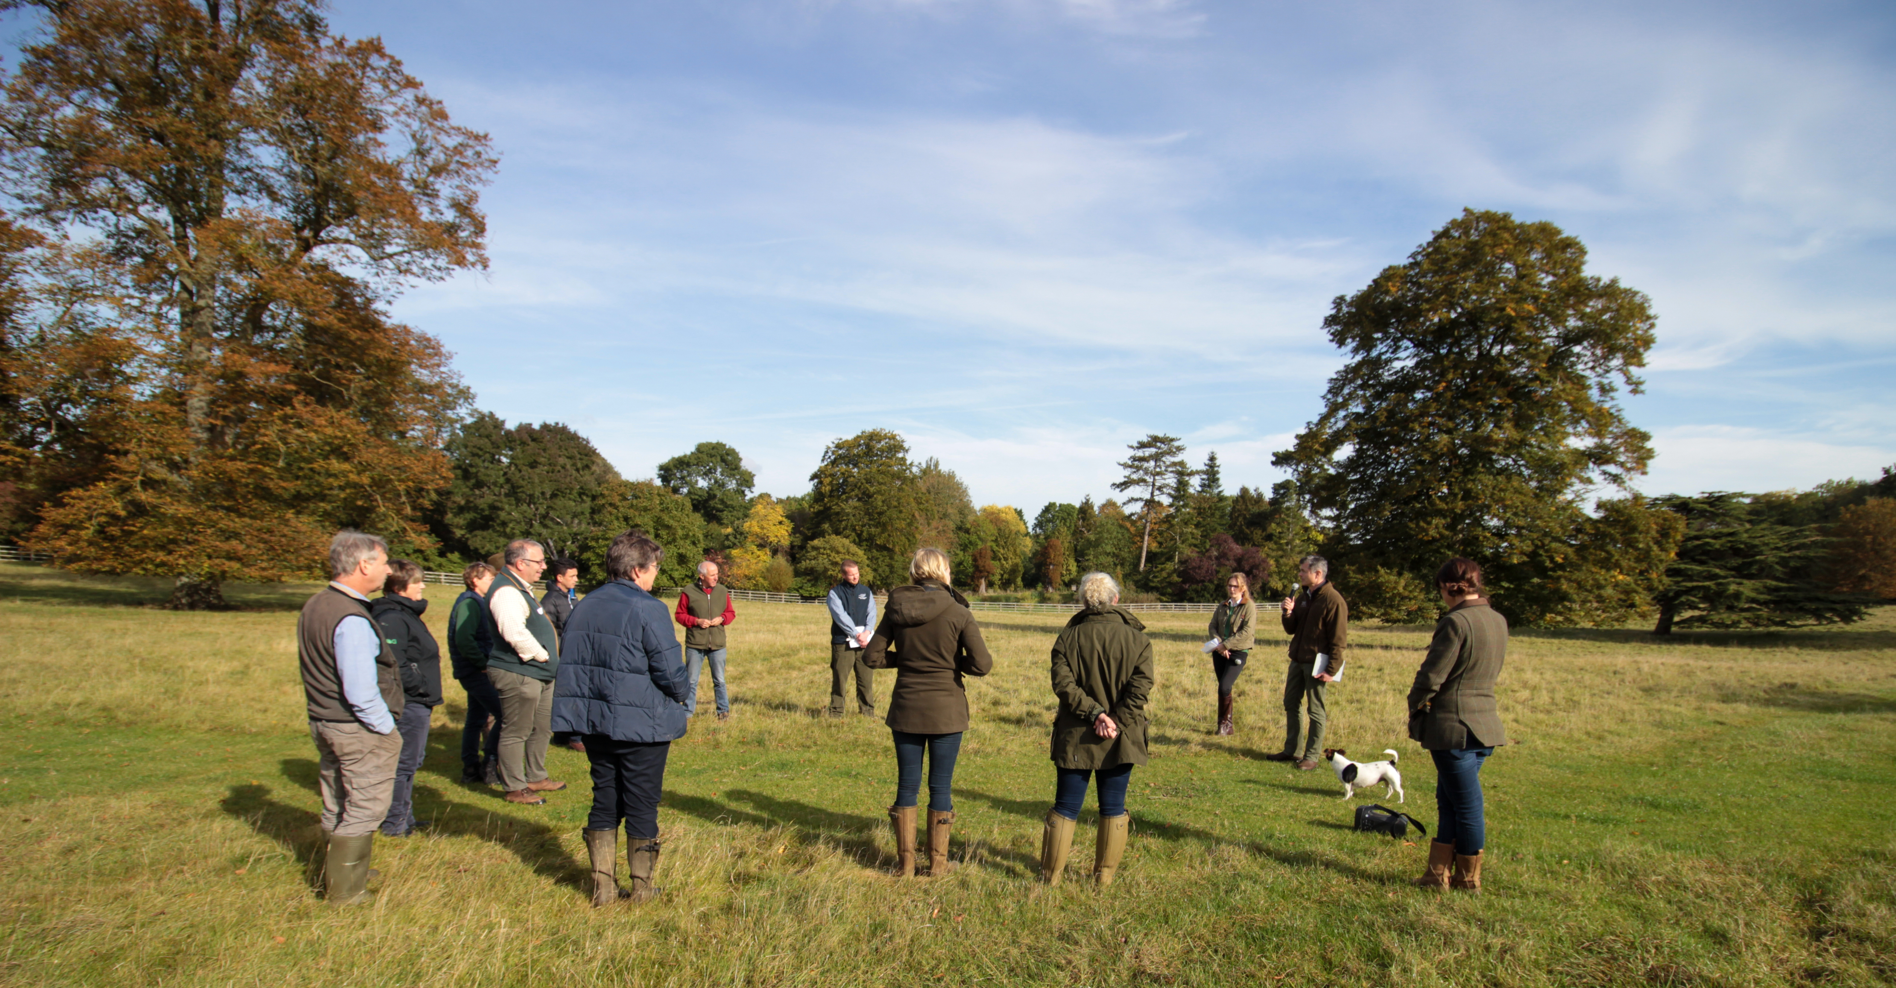
Knowledge generation and exchange
On-farm events, training, projects, working groups. LEAF is also actively involved in several Horizon Europe and similar projects

Slide 12
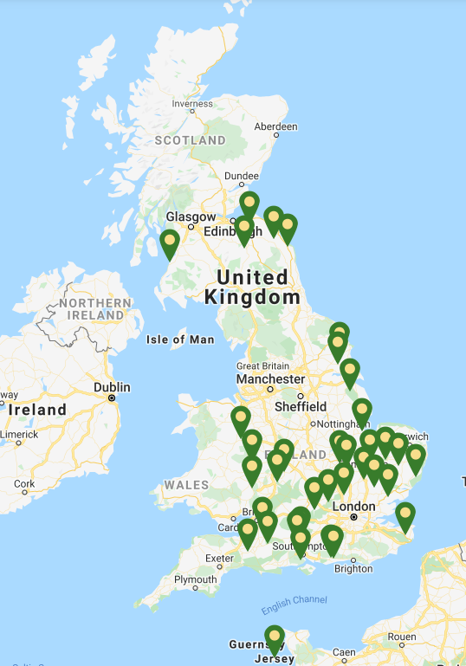
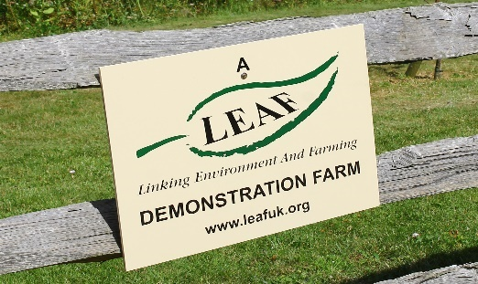
LEAF Demonstration Farms
38 representing all sectors
Commercial farms
Volunteers
9,528 visitors in 2019
6 under project development for 2022 launch

Slide 13

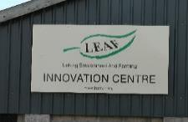










LEAF Innovation Centres 2022
14 in total
Quarterly Network events
Quarterly Innovation News
Development of research output archive
UK wide

Slide 14
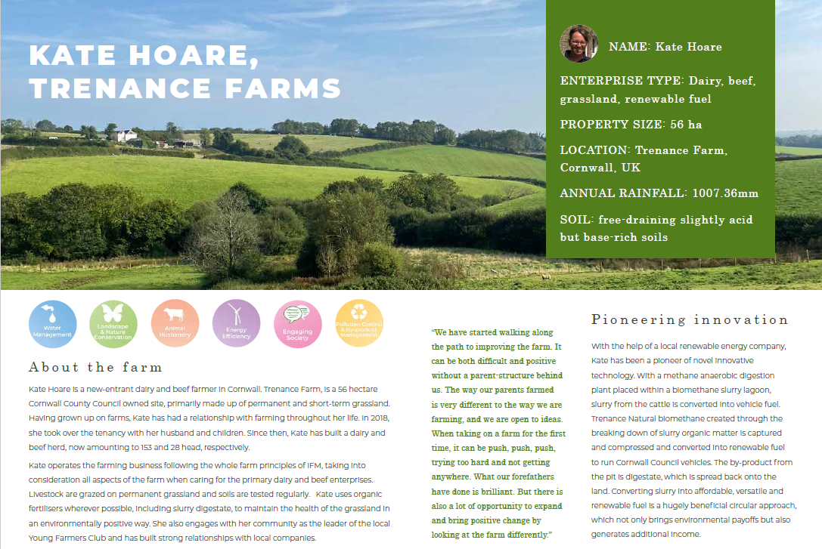

Slide 15
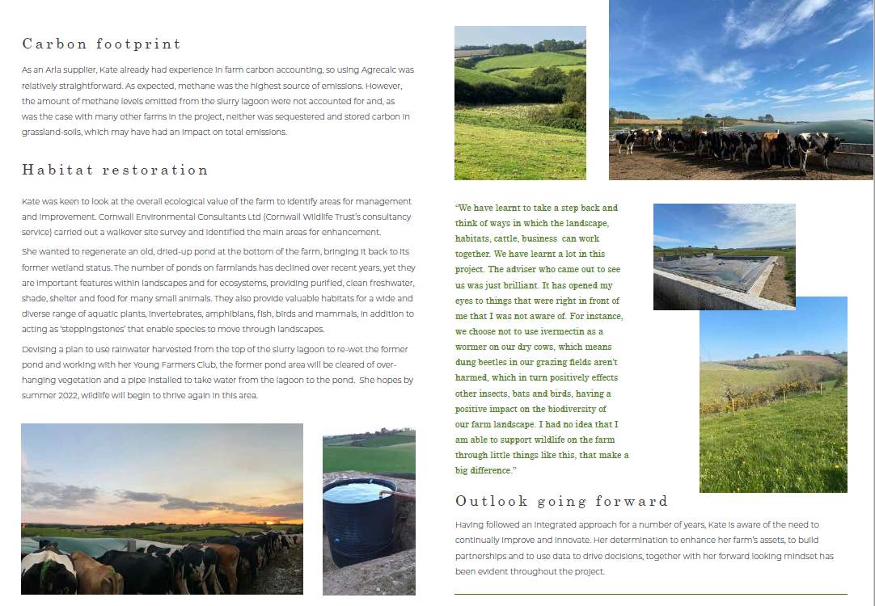

Slide 16
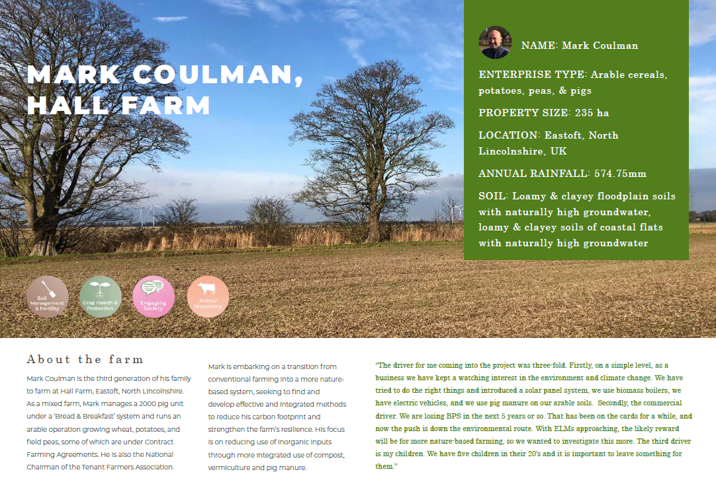

Slide 17
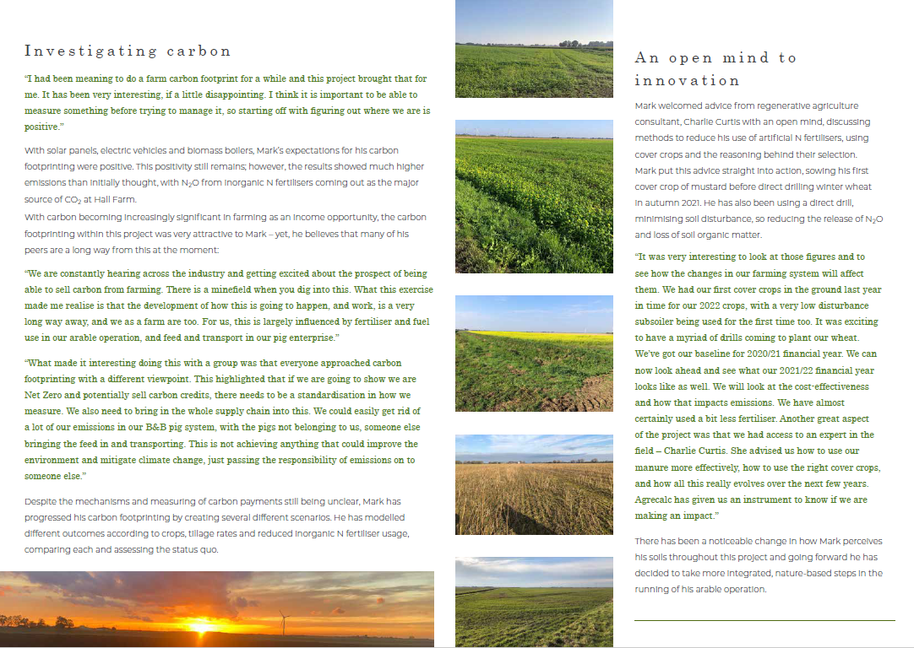

Slide 18
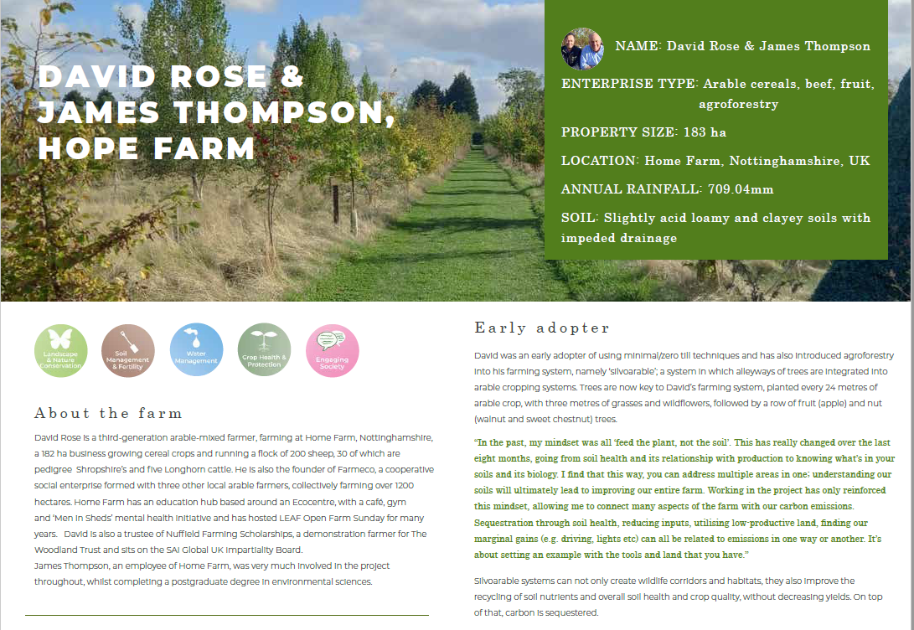

Slide 19
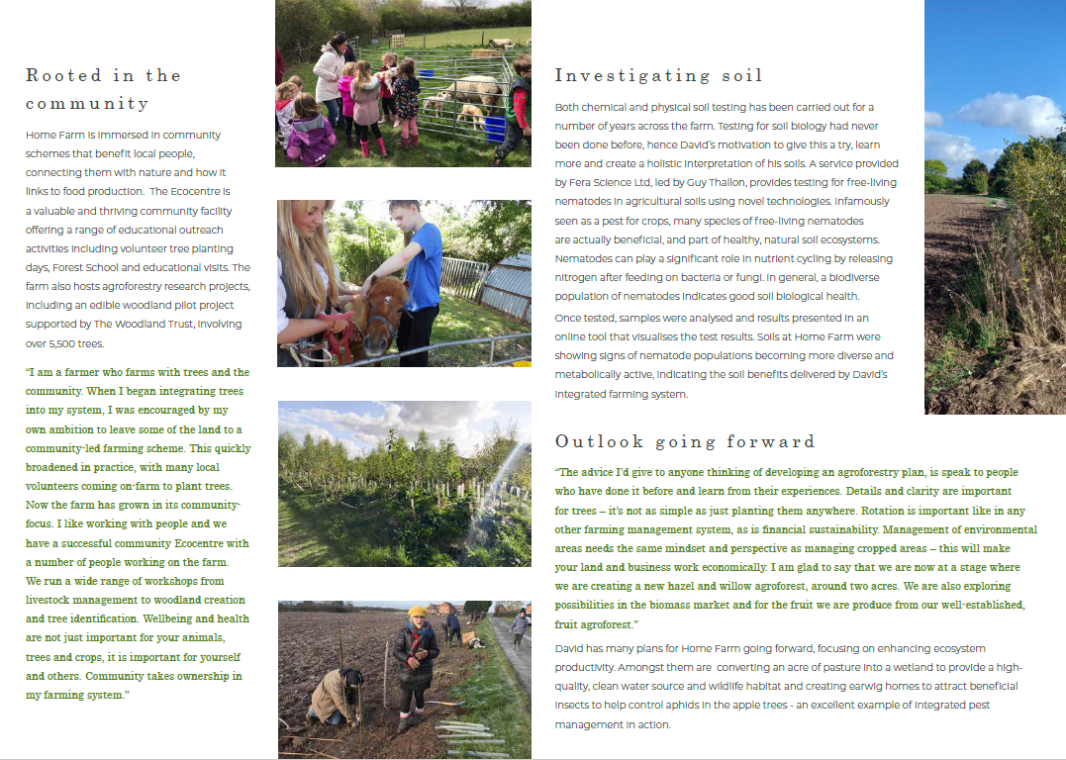

Slide 20
What does the future look like?
Supporting change for all
Transformative
Innovative
Supportive
Scale & speed
‘If you can think it, you can do it’

Slide 21
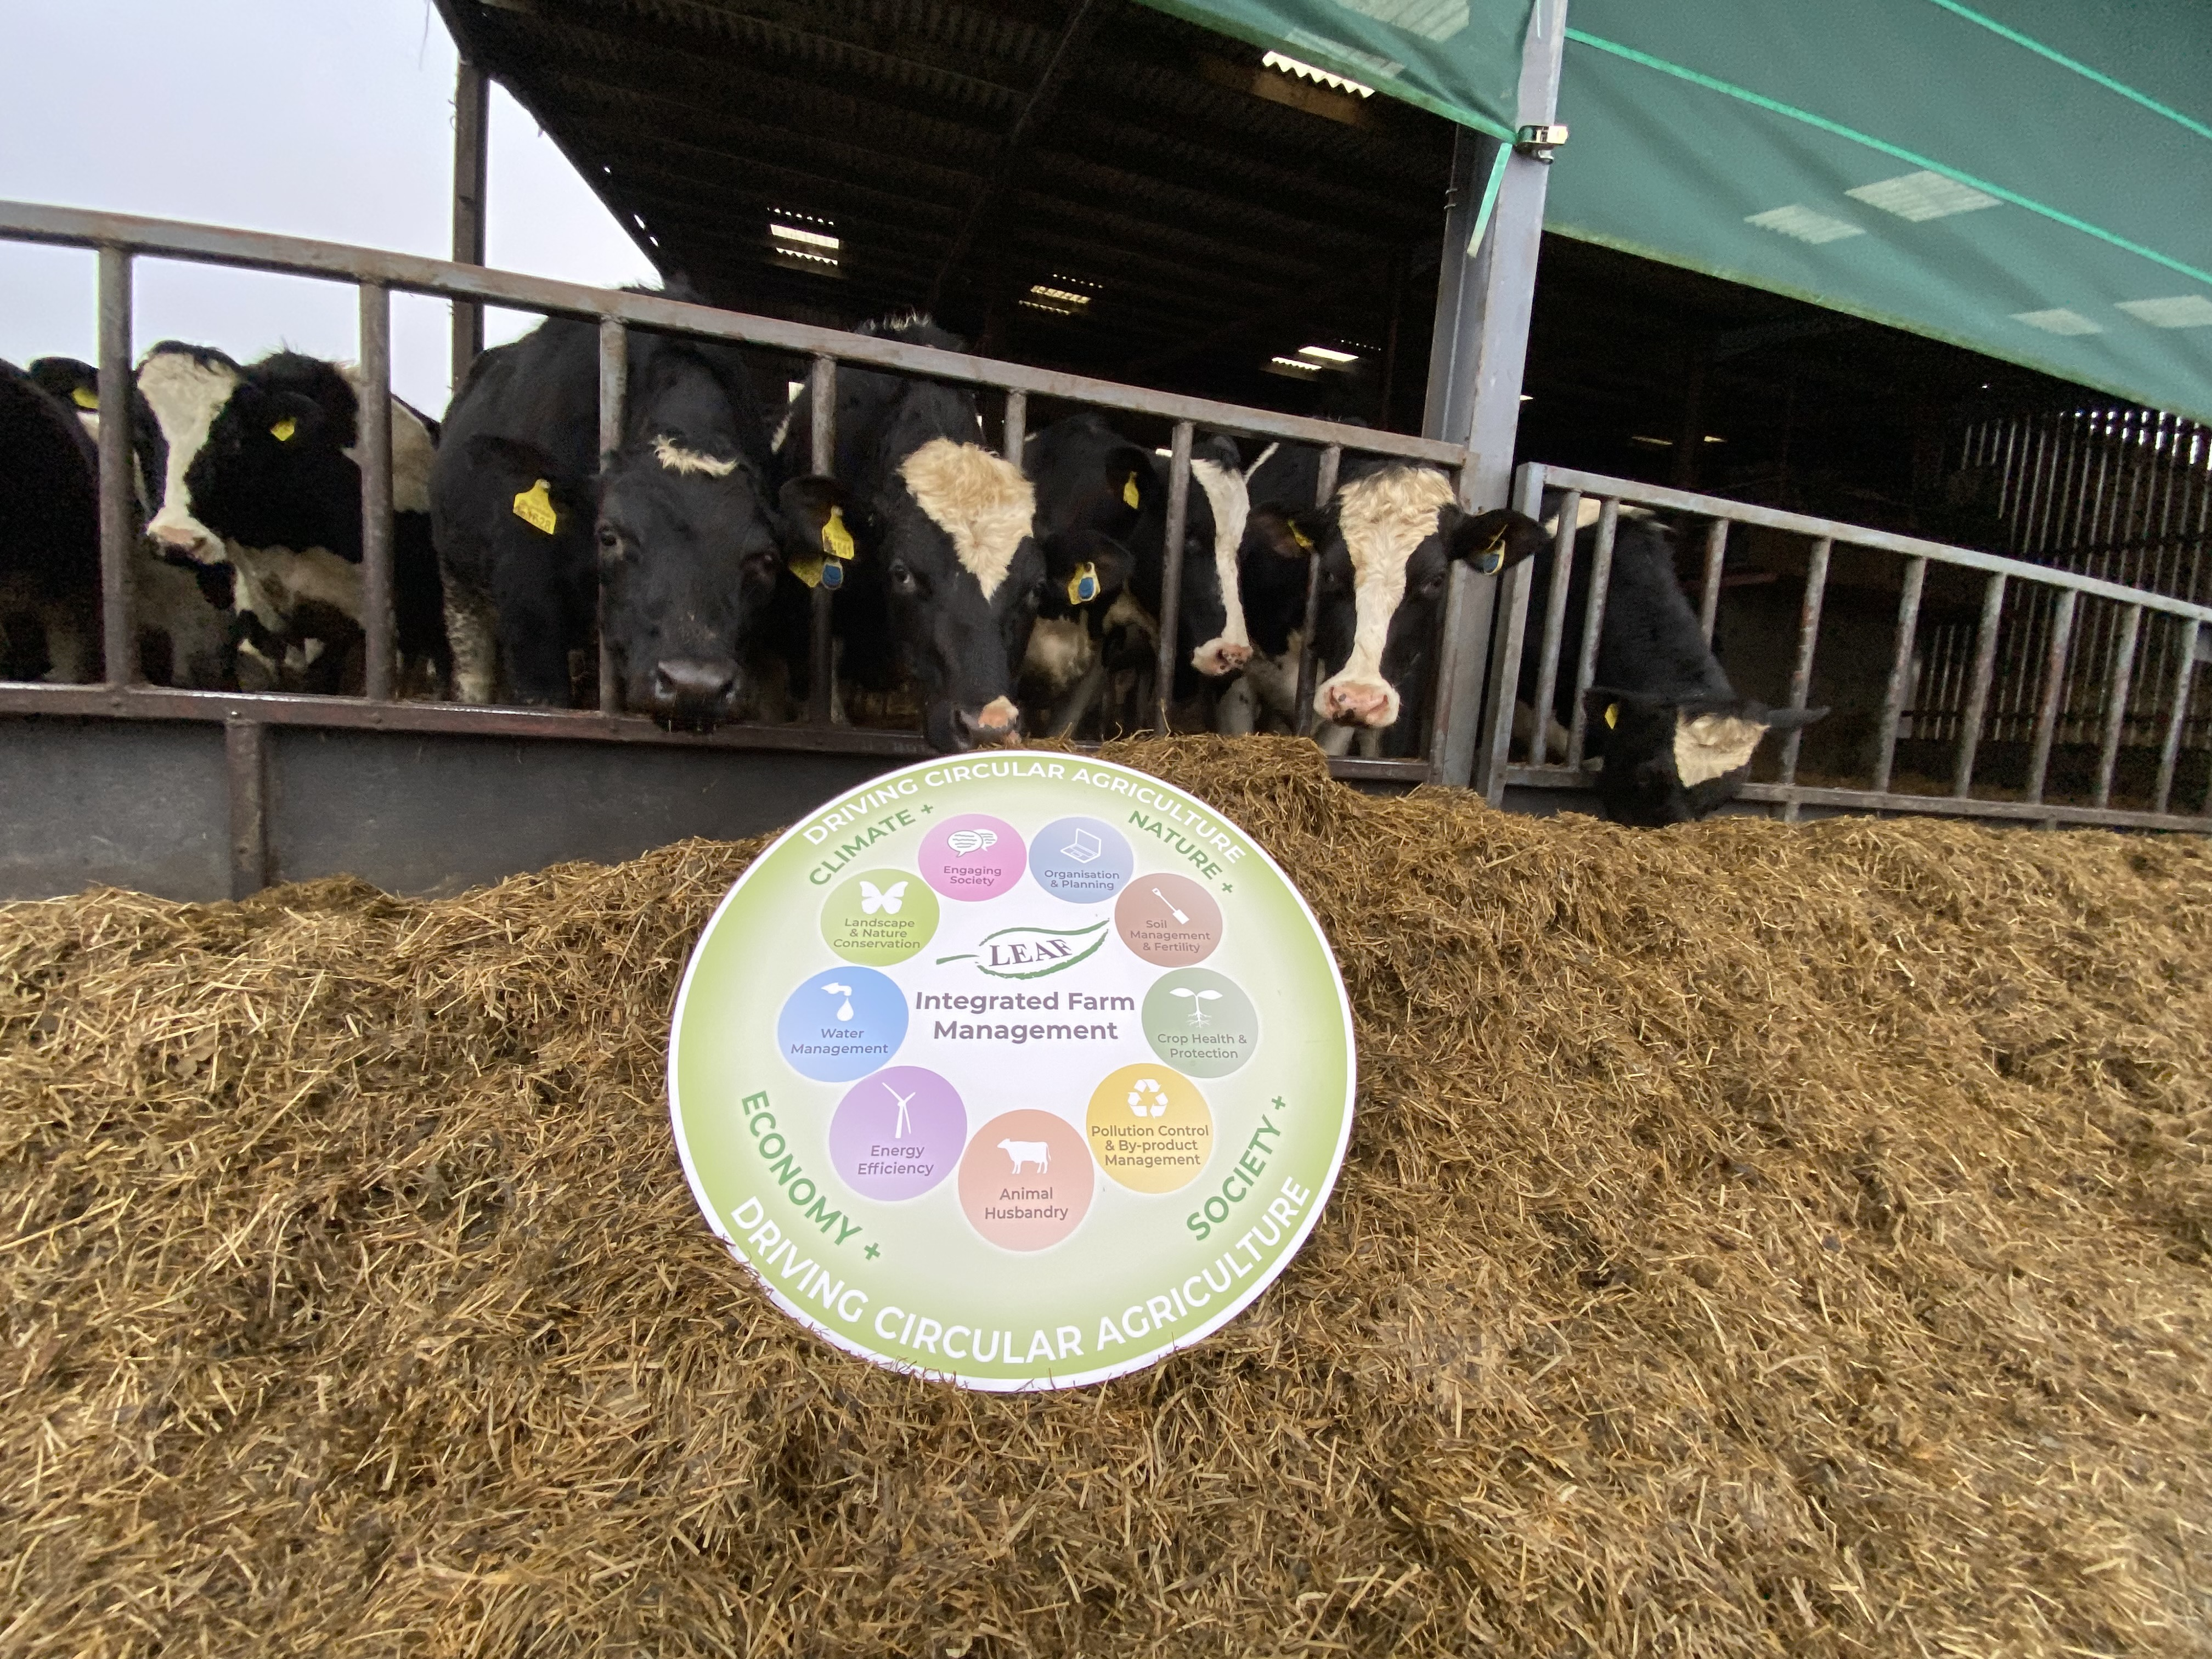
Open for questions!
Thank you…

Slide 22
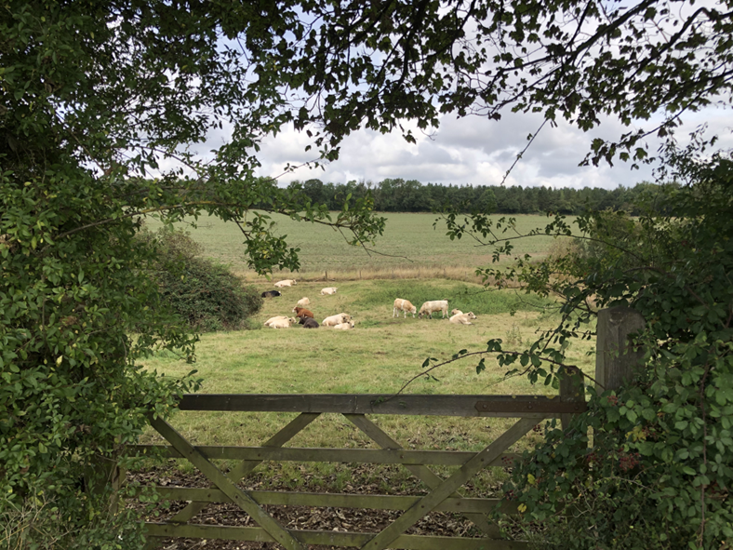
You can’t beat mother nature!

