Slide 1
Agriculture’s Net Zero Challenge:
The Realistic Options
Phil Bicknell
11th May 2022

Slide 2
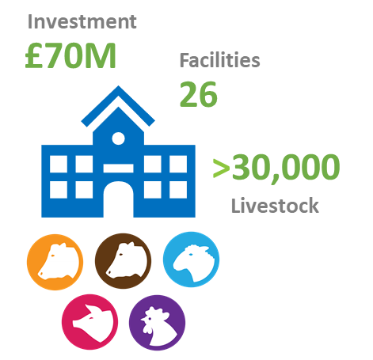
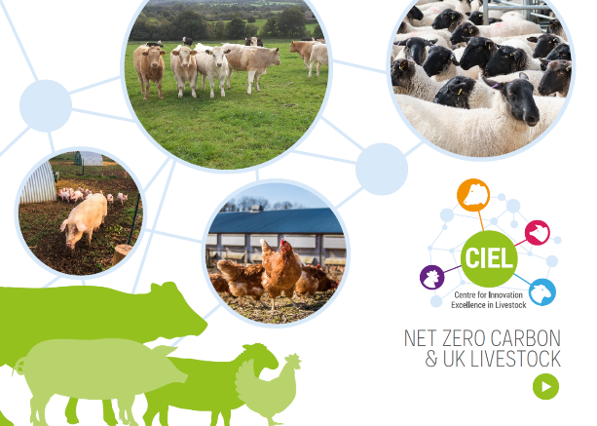

CIEL: the front door to innovation for the livestock sector
Gene Technologies
Health, Welfare & Behaviour
AMR
Resource Efficiency
Environmental Impact
Food Production pre/post-farmgate
Food Safety, Quality & Integrity
Nutrition & Productivity
16
Academic Partners
≈ 800
Researchers
≈ 70
Industry Members
Multi-departmental
Government Partners

Slide 3

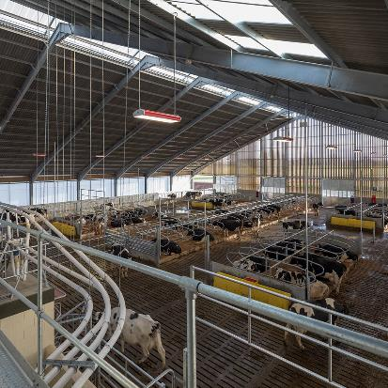
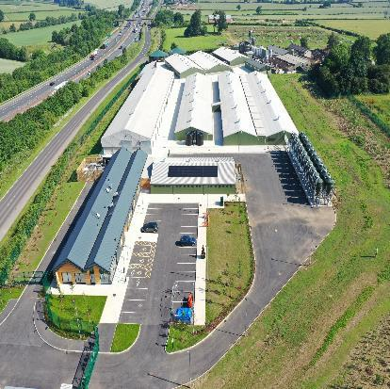




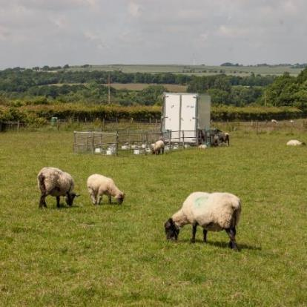
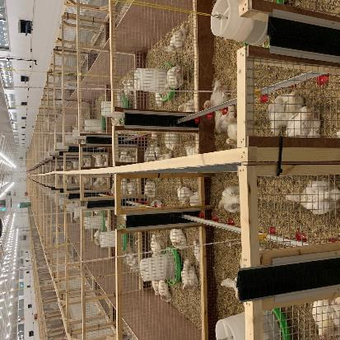



Capability
Network of National Livestock Centres
Dairy
Pig
Centre for Dairy Science Innovation (CDSI)
National Pig Centre
Beef and Sheep
Poultry
North Wyke Farm Platform
Allermuir Avian Innovation and Skills Centre (AISC)

Slide 4
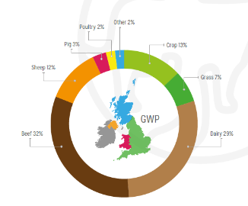
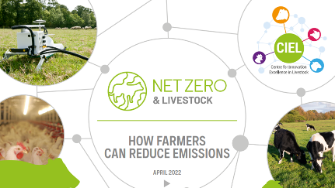
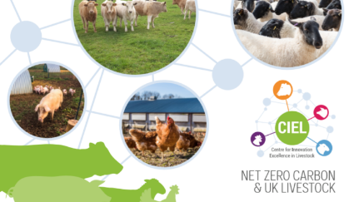


Our collective journey to Net Zero
2050
Reach UK ambition for Net Zero
2022
2020
Net Zero & Livestock: How farmers can reduce emissions
Net Zero Carbon & UK Livestock
Jan22
Sector Surgeries
Pig & Poultry + Ruminants
2021
2023 - onwards
The 2021 United Nations Climate Change Conference
Next steps work
Notes:
1. established benchmarks for a range of farming in the UK.
2. commitment to science based plans focused on recognised methodology, with regular reporting of progress against agreed targets. The need for rapid and coordinated action was the clear and consistent message.
3. 2022 report builds on that by looking at a wide range of ‘mitigations’ - the strategies and technologies that can reduce emissions. This will provide farmers, their advisers, supply chain partners and policymakers with information on a range of options to consider, ultimately supporting better, evidence-based decision-making.
4. Reports on different areas identified (e.g. GWP*) - continuous support
5. Carbon Agriculture will contribute to Net Zero Carbon for the UK by delivering a 64% reduction in carbon emissions by 2050

Slide 5











Helping the UK livestock industry to deliver Net Zero
Aim: Options to reduce emissions at farm level
Scope: Independent consortium of expert scientists provided evidence to assess a range of mitigation options
Research Organisations that contributed to the report:
Research Organisations that endorsed the report:
Notes:
The report aims to provide farmers, advisers, supply chain partners and policymakers with the information to support evidence-based decision making when it comes to farming in a net zero world --- Mitigation = reduction
collaborate
Introduce consortium and why we commissioned these reports Learn more about the finding of these reports from lead authors
And provide you with the opportunity to ask them any questions you may have; after the authors have presented out a panel will discuss more broader issues surrounding net zero

Slide 6

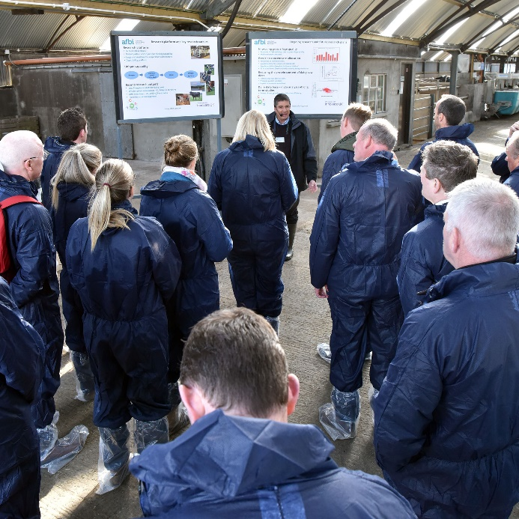
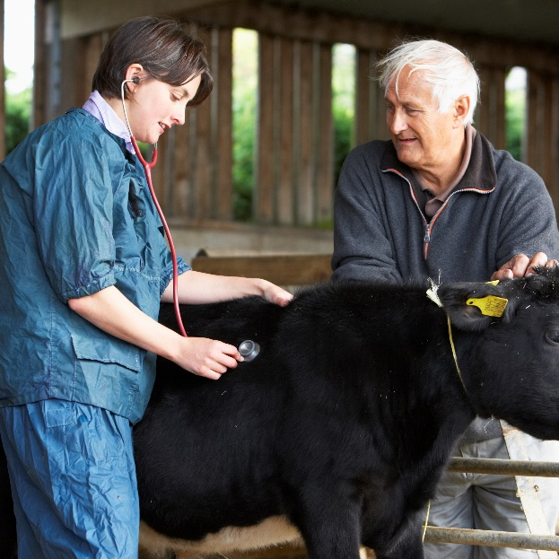
Main findings – way forward
Focus on Efficiency: Adopt mitigations that also increase profit
New technologies: Exploit as they become available
Farm carbon calculators: Essential – Define standard features & reward good practice
Collaboration across sector: Delivering change requires a collective effort
Notes:
1.to deliver maximum change possible. A great start is to
2. (e.g. rumen methane inhibitors, precision feeding, feed plant varieties, animal genetics, recycling waste streams)
3. Carbon calculators are essential tools to help farmers reduce their footprint. & feed accurate consistent information into national emission assessments.
Account for all emissions associated with inputs.
4. Farmers cannot and should not be expected to deliver this on their own. The whole industry must work together.

Slide 7
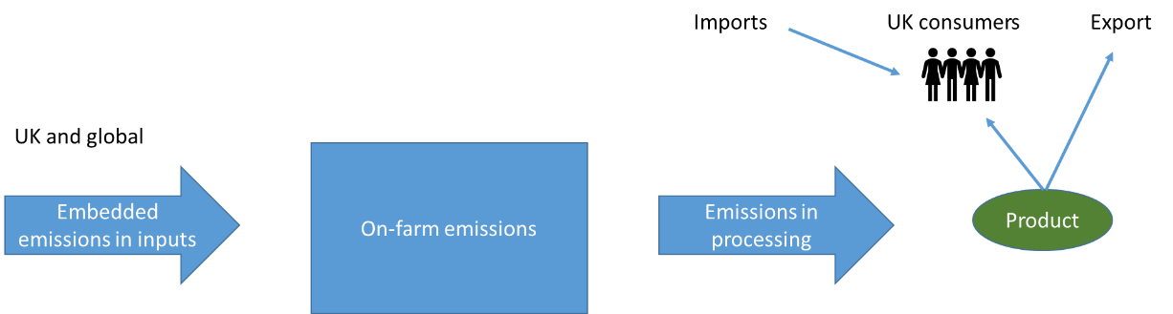
System boundaries very important
National Inventory Emissions vs. Carbon Footprint
UK National
Emission Inventory
Farm or product
Carbon Footprint
Carbon Calculators

Slide 8
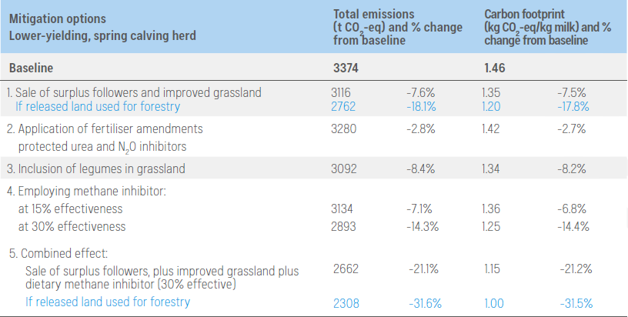
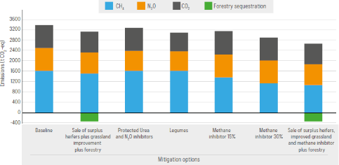
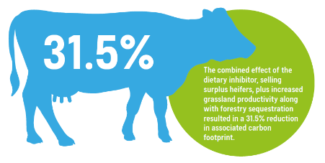
Dairy Case Study Farm Spring calving, grazed grass focus

Slide 9
Where next for CIEL?
Sector briefings
Farming press
Government departments (Defra, DAERA, Welsh & Scottish Govt) + UKRI
Farming Unions & other interested groups
Explore & accelerate Innovation
Consider proposals & collaborations for project development
Asking Members how we can support their businesses
Notes:
CIEL’s role is to help provide the independent science & evidence, promote and support research and innovation, and facilitate collaborations.

Slide 10
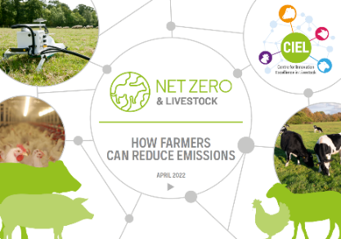
Thanks for listening

